Slide 1
Organizational Behavior
Seventeenth Edition
Chapter 2
Diversity in Organizations
Copyright © 2017, 2015, 2013 Pearson Education, Inc. All Rights Reserved.
Notes:
If this PowerPoint presentation contains mathematical equations, you may need to check that your computer has the following installed:
1) MathType Plugin
2) Math Player (free versions available)
3) NVDA Reader (free versions available)
Welcome to this Organizational Behavior course that uses the 17th edition of the textbook, Organizational Behavior by Robbins and Judge. This is considered among the most widely used OB textbooks in the world. Robbins and Judge are recognized as definitive aggregators of OB concepts, applications, and practices. The course and this book will provide you with a resource that will benefit you throughout your degree program and your professional life.

Slide 2
Learning Objectives
2.1 Describe the two major forms of workplace diversity.
2.2 Demonstrate how workplace discrimination undermines organizational effectiveness.
2.3 Describe how the key biographical characteristics are relevant to OB.
2.4 Explain how other differentiating characteristics factor into OB.
2.5 Demonstrate the relevance of intellectual and physical abilities to OB.
2.6 Describe how organizations manage diversity effectively.
Notes:
After studying this chapter, you should be able to:
Describe the two major forms of workplace diversity.
Demonstrate how workplace discrimination undermines organizational effectiveness.
Describe how the key biographical characteristics are relevant to OB.
Explain how other differentiating characteristics factor into OB.
Demonstrate the relevance of intellectual and physical abilities to OB.
Describe how organizations manage diversity effectively.

Slide 3
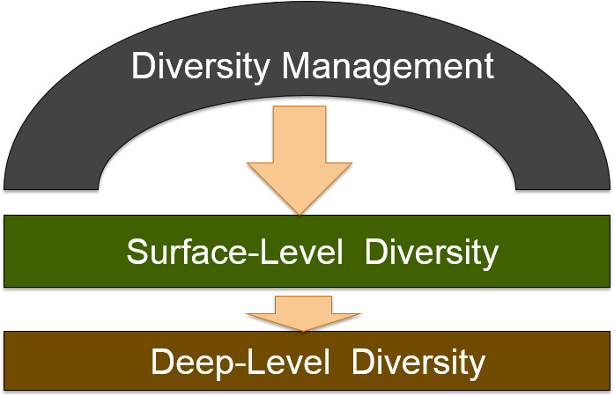
Workplace Diversity
Notes:
Everyone brings differences to the organizations where they work. These differences can create energy and excitement in the workplace, but they can also cause conflict. So it is important that we have an understanding of how diversity works in organizations.
When we look at the workplace, we recognize two levels of diversity. Surface-level diversity represents the characteristics that are easily observed such as race, gender, age, etc. Deep-level diversity represents the aspects that are more difficult to see at first glance such as values, personality, and work preferences.

Slide 4
Workplace Discrimination and Organizational Effectiveness (1 of 3)
Discrimination is to note a difference between things.
Unfair discrimination assumes stereotypes about groups.
Refusal to recognize individual differences is harmful to organizations and employees.
Notes:
Managing diversity effectively requires working to eliminate unfair discrimination. The act of discrimination means to note differences between things, which isn’t a bad thing. However, when we allow our behavior to be influenced by stereotypes about groups of people, unfair discrimination can be harmful to organizations and employees. Recognizing people for their abilities rather than assumptions of stereotypes is an important part of OB and its application to the work environment.

Slide 5
Workplace Discrimination and Organizational Effectiveness (2 of 3)
Exhibit 2-1 Forms of Discrimination
Type of Discrimination | Definition | Examples from Organizations
Discriminatory policies or practices | Actions taken by representatives of the organization that deny equal opportunity to perform or unequal rewards for performance. | Older workers may be targeted for layoffs because they are highly paid and have lucrative benefits.
Sexual harassment | Unwanted sexual advances and other verbal or physical conduct of a sexual nature that create a hostile or offensive work environment. | Salespeople at one company went on company-paid visits to strip clubs, brought strippers into the office to celebrate promotions, and fostered pervasive sexual rumors.
Intimidation | Overt threats or bullying directed at members of specific groups of employees. | African-American employees at some companies have found nooses hanging over their work stations.
Mockery and insults | Jokes or negative stereotypes; sometimes the result of jokes taken too far. | Arab-Americans have been asked at work whether they were carrying bombs or were members of terrorist organizations
Notes:
This Exhibit lists definitions and examples of different types of discrimination. Increasing legal scrutiny and social disapproval have reduced most overt forms of discrimination, but less obvious discrimination, like incivility or exclusion, continue to exist. This type of discrimination can be difficult to eliminate because it’s less easily observed, and because it’s not always intentional. Even so, it can have serious negative implications for an organization including reduced productivity, increased turnover, and increased conflict among employees.

Slide 6
Workplace Discrimination and Organizational Effectiveness (3 of 3)
Exhibit 2-1 [continued]
Type of Discrimination | Definition | Examples from Organizations
Exclusion | Exclusion of certain people from job opportunities, social events, discussions, or informal mentoring; can occur unintentionally. | Many women in finance claim they are assigned to marginal job roles or are given light workloads that don’t lead to promotion
Incivility | Disrespectful treatment, including behaving in an aggressive manner, interrupting the person, or ignoring his or her opinions | Female lawyers note that male attorneys frequently cut them off or do not adequately address their comments.
Sources: J. Levitz and P. Shishkin, “More Workers Cite Age Bias after Layoffs,” The Wall Street Journal, March 11, 2009, D1–D2; W. M. Bulkeley, “A Data-Storage Titan Confronts Bias Claims,” The Wall Street Journal, September 12, 2007, A1, A16; D. Walker, “Incident with Noose Stirs Old Memories,” McClatchy-Tribune Business News, June 29, 2008; D. Solis, “Racial Horror Stories Keep EEOC Busy,” Knight-Ridder Tribune Business News, July 30, 2005, 1; H. Ibish and A. Stewart, Report on Hate Crimes and Discrimination against Arab Americans: The Post-September 11 Backlash, September 11, 2001–October 11, 2001 (Washington, DC: American-Arab Anti-Discrimination Committee, 2003); A. Raghavan, “Wall Street’s Disappearing Women,” Forbes, March 16, 2009, 72–78; and L. M. Cortina, “Unseen Injustice: Incivility as Modern Discrimination in Organizations,” Academy of Management Review 33, no. 1 (2008): 55–75.
Notes:
This Exhibit lists definitions and examples of different types of discrimination. Increasing legal scrutiny and social disapproval have reduced most overt forms of discrimination, but less obvious discrimination, like incivility or exclusion, continue to exist. This type of discrimination can be difficult to eliminate because it’s less easily observed, and because it’s not always intentional. Even so, it can have serious negative implications for an organization including reduced productivity, increased turnover, and increased conflict among employees.

Slide 7
Biographical Characteristics and Organizational Behavior (1 of 6)
Biological characteristics are personal characteristics that are objective and easily obtained from personnel records.
Variations in these can be the basis for discrimination
Notes:
Biographical characteristics typically include age, gender, and race, and represent many of the surface-level aspects of diversity. We can usually find out about these from personnel records. Because biological characteristics can be the basis for discrimination, it’s important to understand how they are related to work outcomes.

Slide 8
Biographical Characteristics and Organizational Behavior (2 of 6)
Age
The U.S. workforce is aging.
Does job performance decline with increasing age?
Studies show that turnover and absenteeism rates are lower among older workers, and age is not associated with lower productivity.
Notes:
Age is an increasingly relevant characteristic as the workforce is aging. Older workers bring with them a wealth of knowledge and experience, but the misperception is that productivity often declines with age. Whether this is true or not, it is a perception people act upon and will affect the workplace.

Slide 9
Biographical Characteristics and Organizational Behavior (3 of 6)
Sex
There are no consistent male-female differences in problem-solving ability, analytical skills, competitive drive, motivation, sociability, or learning drive.
But women earn less than men for the same positions and have fewer professional opportunities.
Notes:
Another biological characteristic is sex. In studying gender in the workplace, it has been found that there are very few differences between men and women that impact job performance. However, women still earn less money than men for the same positions and working mothers may face additional bias that limits their professional opportunities.

Slide 10
Biographical Characteristics and Organizational Behavior (4 of 6)
Race and Ethnicity
Employees tend to favor colleagues of their own race in performance evaluations, promotion decisions, and pay raises.
African Americans and Hispanics receive higher levels of discrimination in the workplace.
African Americans generally fare worse than Whites in employment decisions.
Notes:
Race is a controversial issue and research shows members of racial and ethnic minorities perceive discrimination in the workplace. More specifically, studies indicate that people in the workplace do identify more with people like themselves; so in some cases, opportunities may be given to people based on the fact that they are like their supervisor, rather than on their merits. Keep in mind, though, that research has found no significant differences in race or ethnic backgrounds related to absence rates, applied social skills, or accident rates, and that discrimination can lead to higher turnover.

Slide 11
Biographical Characteristics and Organizational Behavior (5 of 6)
Disabilities
The U.S. Equal Employment Opportunity Commission classifies a person as disabled who has any physical or mental impairment that substantially limits one or more major life activities.
Workers with disabilities receive higher performance evaluations, but may have lower performance expectations.
Notes:
According to the U.S. Equal Employment Opportunity Commission, a person with a disability is one who has a physical or mental impairment that limits one or more major life activities. The Americans with Disabilities Act of 1990 requires employers to make “reasonable accommodation” for disabilities. Even so, individuals with disabilities continue to face bias in the workplace.

Slide 12
Biographical Characteristics and Organizational Behavior (6 of 6)
Hidden Disabilities
Sensory disabilities, chronic illness or pain, cognitive or learning impairments, sleep disorders, and psychological challenges.
U.S. organizations must accommodate employees with a very broad range of impairments.
Notes:
As a result of recent changes to the Americans with Disabilities Act Amendments Act of 2008, U.S. organizations must accommodate employees with a very broad range of impairments such as sensory disabilities, chronic illness or pain, cognitive or learning impairments, sleep disorders, and psychological challenges. However, employees must disclose their conditions to their employers in order to be eligible for workplace accommodations and employment protection.

Slide 13
Other Characteristics and Organizational Behavior (1 of 2)
Tenure
Tenure is a good predictor of employee productivity.
Tenure and job satisfaction are positively related.
Religion
U.S. law prohibits discrimination based on religion, but it is still an issue, especially for Muslims.
Notes:
Tenure refers to the length of time people have been on the job. Tenure is often seen as a positive, as it signifies that people are happy with their employment because they have remained in their job for a long period of time. Therefore, employees with long tenure tend to be more productive, call in sick less frequently, and don’t leave the organization as readily.
Discrimination based on religion is prohibited in the United States; however, it continues to be an issue in the workplace. Muslims in particular may face discrimination, but bias against other religious beliefs exists as well. In fact, religious discrimination claims represent an increasing share of all discrimination claims in the United States.

Slide 14
Other Characteristics and Organizational Behavior (2 of 2)
Sexual Orientation and Gender Identity
Federal law does not protect employees against discrimination based on sexual orientation, but this may soon change.
Most Fortune 500 companies have policies covering sexual orientation and about half now have policies on gender identity.
Cultural Identity
Need to accommodate and respect individual cultural identities.
Notes:
Sexual orientation and gender identity are not protected by federal law and as a result, they are handled differently by most employers. These characteristics are often dealt with as if they are federally-protected characteristics even though they are not, in order to discourage discriminatory behavior. For example, about 90 percent of Fortune 500 companies have policies on sexual orientation and roughly half have policies on gender identity. This is a big change from just a few years ago, and there are indications that legislation may soon be in place to protect gay, lesbian, bisexual, and transgender employees.
Finally, it is important for companies to respect and accommodate the cultural identities of their employees.

Slide 15
Intellectual and Physical Abilities and OB (1 of 5)
Ability is an individual’s current capacity to perform various tasks in a job.
Two types
Intellectual abilities
Physical abilities
Notes:
Ability is an individual’s capacity to perform job tasks. An individual’s overall abilities are comprised of intellectual abilities and physical abilities.

Slide 16
Intellectual and Physical Abilities and OB (2 of 5)
Intellectual abilities are abilities needed to perform mental activities – thinking, reasoning, and problem solving.
Most societies place a high value on intelligence.
General mental ability is an overall factor of intelligence as suggested by the positive correlations among specific intellectual ability dimensions.
Notes:
Intellectual abilities are those needed to perform mental activities. These would include abilities like critical thinking, reasoning, and problem solving. In most cultures, high value is placed on intelligence and it is easy to see why. Smart people tend to earn more money, attain higher levels of education, and be leaders.

Slide 17
Intellectual and Physical Abilities and OB (3 of 5)
Exhibit 2-2 Dimensions of Intellectual Ability
Dimension | Description | Job Example
Number aptitude | Ability to do speedy and accurate arithmetic | Accountant: Computing the sales tax on a set of items
Verbal comprehension | Ability to understand what is read or heard and the relationship of words to each other | Plant manager: Following corporate policies on hiring
Perceptual speed | Ability to identify visual similarities and differences quickly and accurately | Fire investigator: Identifying clues to support a charge of arson
Inductive reasoning | Ability to identify a logical sequence in a problem and then solve the problem | Market researcher: Forecasting demand for a product in the next time period
Deductive reasoning | Ability to use logic and assess the implications of an argument | Supervisor: Choosing between two different suggestions offered by employees
Spatial visualization | Ability to imagine how an object would look if its position in space were changed | Interior decorator: Redecorating an office
Memory | Ability to retain and recall past experiences | Salesperson: Remembering the names of customers
Notes:
The seven most frequently cited dimensions making up intellectual abilities are number aptitude, verbal comprehension, perceptual speed, inductive reasoning, deductive reasoning, spatial visualization, and memory.
Exhibit 2-2 describes these dimensions. If you score high on verbal comprehension, you’re more likely to also score high on spatial visualization. Evidence strongly supports the idea that the structures and measures of intellectual abilities generalize across cultures.

Slide 18
Intellectual and Physical Abilities and OB (4 of 5)
Physical Abilities
The capacity to do tasks demanding stamina, dexterity, strength, and similar characteristics.
Nine basic abilities related to strength, flexibility, and other factors are needed to perform physical tasks.
Notes:
Physical abilities are needed when performance requires physical activity to complete a task. Research has identified nine basic abilities that are needed to perform physical tasks – they are shown in the following slide. Managers need to identify which of these abilities are necessary for specific jobs, and then ensure that people in those jobs have the necessary abilities to do their jobs successfully.

Slide 19
Intellectual and Physical Abilities and OB (5 of 5)
Exhibit 2-3 Nine Basic Physical Abilities
Strength Factors | Black
1. Dynamic strength | Ability to exert muscular force repeatedly or continuously over time
2. Trunk strength | Ability to exert muscular strength using the trunk (particularly abdominal) muscles
3. Static strength | Ability to exert force against external objects
4. Explosive strength | Ability to expend a maximum of energy in one or a series of explosive acts
Flexibility Factors | Black
5. Extent flexibility | Ability to move the trunk and back muscles as far as possible
6. Dynamic flexibility | Ability to make rapid, repeated flexing movements
Other Factors | Black
7. Body coordination | Ability to coordinate the simultaneous actions of different parts of the body
8. Balance | Ability to maintain equilibrium despite forces pulling off balance
9. Stamina | Ability to continue maximum effort requiring prolonged effort over time
Notes:
Exhibit 2-3 shows the nine basic physical abilities needed to perform physical tasks. Strength factors include dynamic strength, trunk strength, static strength, and explosive strength. Flexibility factors include both components of extent flexibility and dynamic flexibility. Other factors include body coordination, balance, and stamina.

Slide 20
Describe How Organizations Manage Diversity Effectively (1 of 5)
Diversity management is the process and programs by which managers make everyone more aware of and sensitive to the needs and differences of others.
Diversity is more successful when it is everyone’s business, not just for certain groups of employees.
Notes:
Diversity management makes everyone more aware of and sensitive to the needs and differences of others. Diversity management programs are more successful when they are the norm for everyone, rather than just for certain groups of employees.

Slide 21
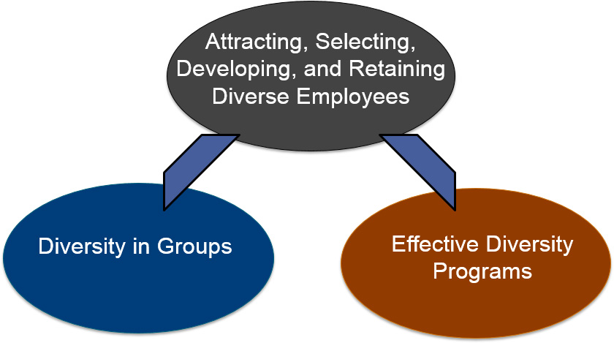
Describe How Organizations Manage Diversity Effectively (2 of 5)
Notes:
Managing diversity effectively begins by attracting, selecting, developing, and retaining employees who can operate and excel in a workplace with diverse individuals, viewpoints, and ideas. These efforts are then complemented by effectively managing diversity in groups and ensuring that strong diversity programs are in place.

Slide 22
Describe How Organizations Manage Diversity Effectively (3 of 5)
Attracting, selecting, developing, and retaining diverse employees
Target recruiting messages to specific demographic groups.
Ensure that hiring is bias free.
Create a positive diversity climate.
Notes:
Attracting, selecting, developing, and retaining diverse employees are important to the process. Recruiting messages should be targeted to specific demographic groups that are underrepresented in the workforce. In addition, fairness and objectivity in the selection process will help ensure that one’s qualifications are emphasized, rather than demographic characteristics. Creating a positive diversity climate is essential for minimizing turnover and increasing commitment to the organization.

Slide 23
Describe How Organizations Manage Diversity Effectively (4 of 5)
Diversity in groups
Most people in groups need a common way of looking at and accomplishing major tasks, and they need to communicate well with each other.
Emphasize higher-level similarities among people.
Notes:
Working in group settings is common in most contemporary workplaces. To be effective members of a group, employees need a common way of looking at and accomplishing major tasks, as well as good communication skills. Emphasizing higher-level similarities can also increase the effectiveness of groups.

Slide 24
Describe How Organizations Manage Diversity Effectively (5 of 5)
Effective diversity programs
Teach managers about the legal framework for equal employment opportunity and encourage fair treatment of all people.
Teach managers how a diverse workforce will be more effective at serving a diverse customer base.
Foster personal development practices that bring out the skills and abilities of everyone.
Notes:
Effective diversity programs have three components. First, they teach managers about the legal framework for equal employment opportunity and encourage fair treatment of all people regardless of their demographic characteristics. Second, they teach managers how a diverse workforce will be better able to serve a diverse market of customers and clients. Finally, they foster personal development practices that bring out the skills and abilities of all workers, acknowledging how differences in perspective can be a valuable way to improve performance for everyone.

Slide 25
Implications for Managers
Understand your organization's anti-discrimination policies thoroughly and share them with your employees.
Assess and challenge your own stereotype beliefs to increase your objectivity.
Look beyond readily observable biographical characteristics and consider the individual’s capabilities before making management decisions.
Fully evaluate what accommodations a person with disabilities will need and then fine-tune a job to that person’s abilities.
Seek to understand and respect the unique biographical characteristics of your employees; a fair but individualistic approach yields the best performance.
Notes:
Understand your organization's anti-discrimination policies thoroughly and share them with your employees.
Assess and challenge your stereotype beliefs to increase your objectivity.
Look beyond readily observable biographical characteristics and consider the individual’s capabilities before making management decisions.
Fully evaluate what accommodations a person with disabilities will need and then fine-tune a job to that person’s abilities.
Seek to understand and respect the unique biographical characteristics of your employees; a fair but individualistic approach yields the best performance.

Slide 26
Copyright

