Slide 1
MANAGEMENT
TWELFTH EDITION
Ricky W. Griffin
Part Three: Planning and Decision Making
Chapter Eight: Managing Decision Making and Problem Solving

Slide 2
Learning Outcomes
Define decision making and discuss types of decisions and decision-making conditions.
Discuss rational perspectives on decision making, including the steps in rational decision making.
Describe the behavioral aspects of decision making.
Discuss group and team decision making, including the advantages and disadvantages of group and team decision making and how it can be more effectively managed.

Slide 3
The Nature of Decision Making
Decision making
Is the act of choosing one alternative from among a set of alternatives.
Decision-making process
Includes recognizing and defining the nature of a decision situation, identifying alternatives, choosing the “best” alternative, and putting it into practice.
“Best” implies that decisions should be effective.

Slide 4
Types of Decisions
Programmed decision
One that is fairly structured or recurs with some frequency, or both.
Nonprogrammed decision
Is relatively unstructured and occurs much less often.

Slide 5
Decision-Making Conditions
State of certainty
A condition in which the decision maker knows with reasonable certainty what the alternatives are and what conditions are associated with each alternative.
State of risk
A condition in which the availability of each alternative and its potential payoffs and costs are all associated with probability estimates.
State of uncertainty
A condition in which the decision maker does not know all the alternatives, the risks associated with each, or the consequences each alternative is likely to have.

Slide 6
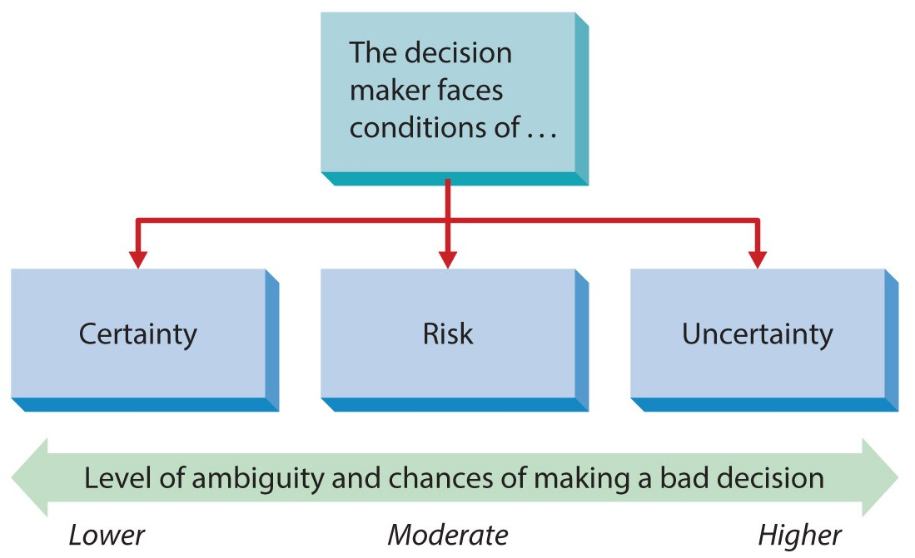
Figure 8.1
Decision-Making Conditions
Most major decisions in organizations today are made under a state of uncertainty.

Slide 7
Rational Perspectives on Decision Making
The classical decision model:
is a prescriptive approach that tells managers how they should make decision;
assumes that managers are logical and rational and their decisions will be in the best interests of the organization.

Slide 8
Figure 8.2
The Classical Model of Decision Making
These conditions rarely, if ever, actually exist.

Slide 9
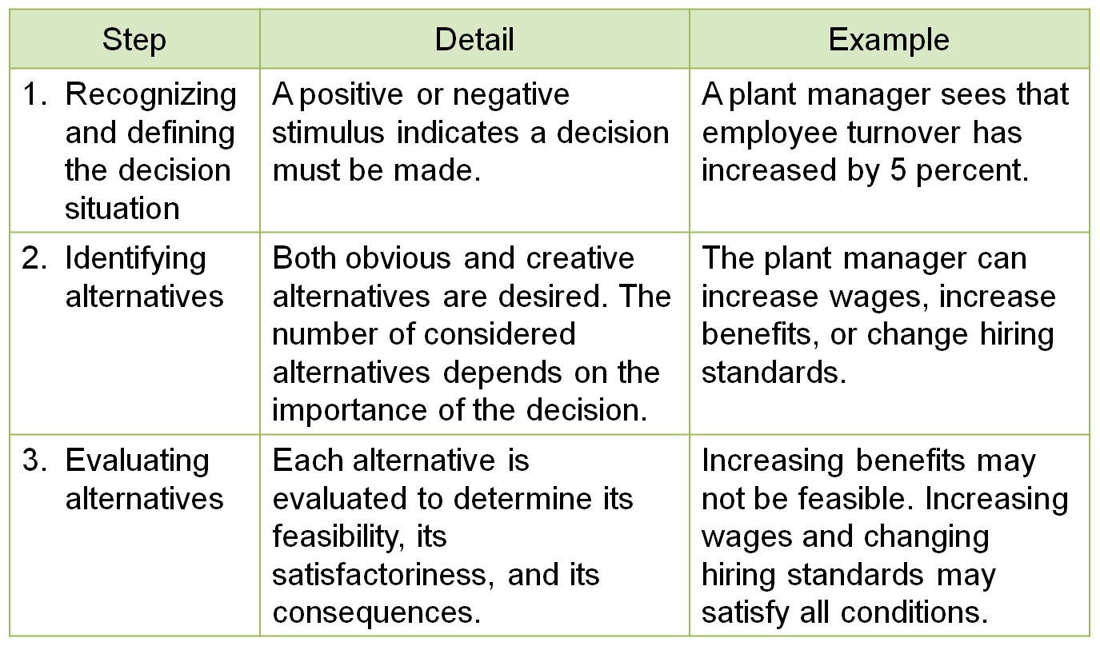
Table 8.1
Rational Decision-Making Steps 1-3

Slide 10
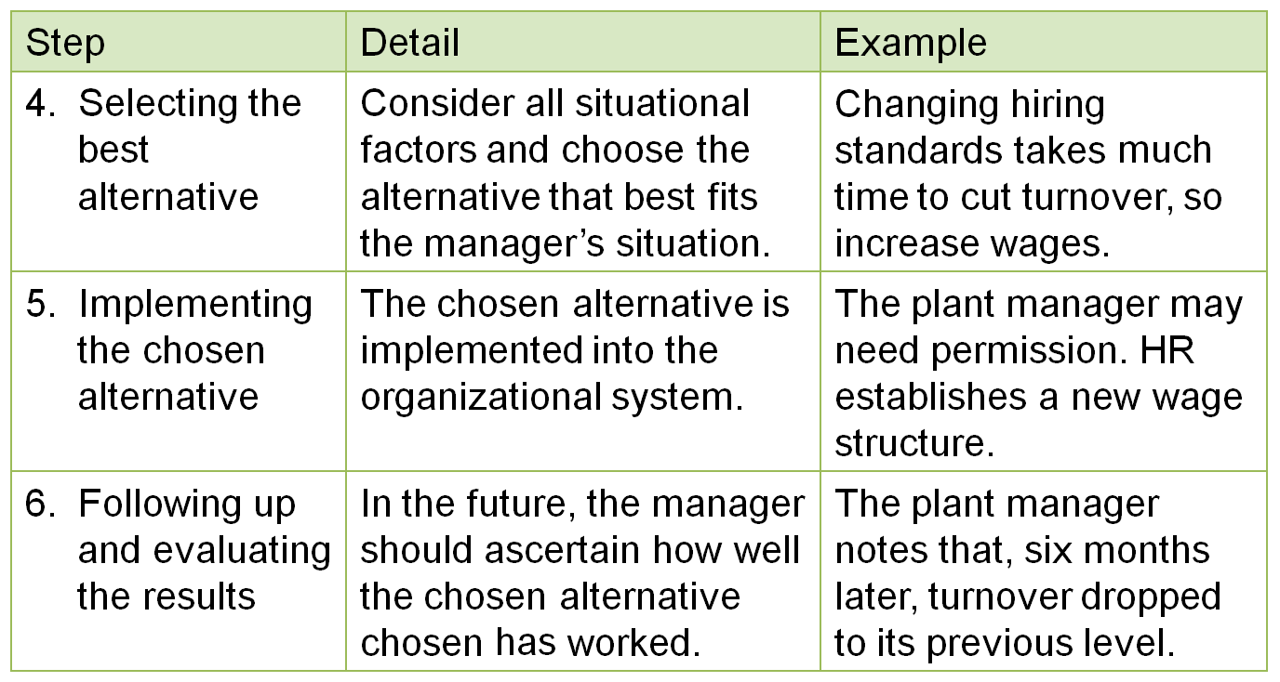
Table 8.1
Rational Decision-Making Steps 4-6

Slide 11
Figure 8.3
Evaluating Alternatives in the
Decision-Making Process
Managers must thoroughly evaluate all alternatives, which increases the chances of success.

Slide 12
Evidence-Based Management
Evidence-Based Management (EBM)
uses rationality and evidence when making decisions.
Build a culture of truth.
Obtain the best evidence and let it guide actions.
Encourage experimentation and learning by doing.
Look for risks and drawbacks in recommendations.
Avoid basing decisions on beliefs.

Slide 13
Behavioral Elements in Decision Making
Administrative Model
Political forces
Intuition
Escalation of commitment
Risk propensity
Ethics
The administrative model better reflects subjective considerations.

Slide 14
Behavioral Elements in Decision Making
The administrative model argues that decision makers:
use incomplete and imperfect information;
are constrained by bounded rationality;
and tend to “satisfice” when deciding.
Bounded rationality
decision makers are limited by their values and unconscious reflexes, skills, and habits.
Satisficing
searching for alternatives until one is found that meets some minimum standard of sufficiency.

Slide 15
Figure 8.4
Administrative Model of Decision Making
The administrative model is quite different from the classical model, but it is equally useful in understanding decision making.

Slide 16
Behavioral Elements in Decision Making
A coalition is an informal alliance formed to achieve a common goal.
Intuition is an innate belief about something without conscious deliberation.
Escalation of commitment is when managers stay with a decision even if wrong.
Risk propensity is the extent to which a decision maker gambles when deciding.
Personal ethics affect decisions.

Slide 17
Group and Team Decision Making in Organizations
Forms of group and team decision making.
Interacting groups and teams
Members openly discuss, argue about, and agree on the best alternative. The most common form.
Delphi groups
A group is used to achieve a consensus of expert opinion.
Nominal groups
A structured technique used to generate creative and innovative alternatives or ideas.

Slide 18
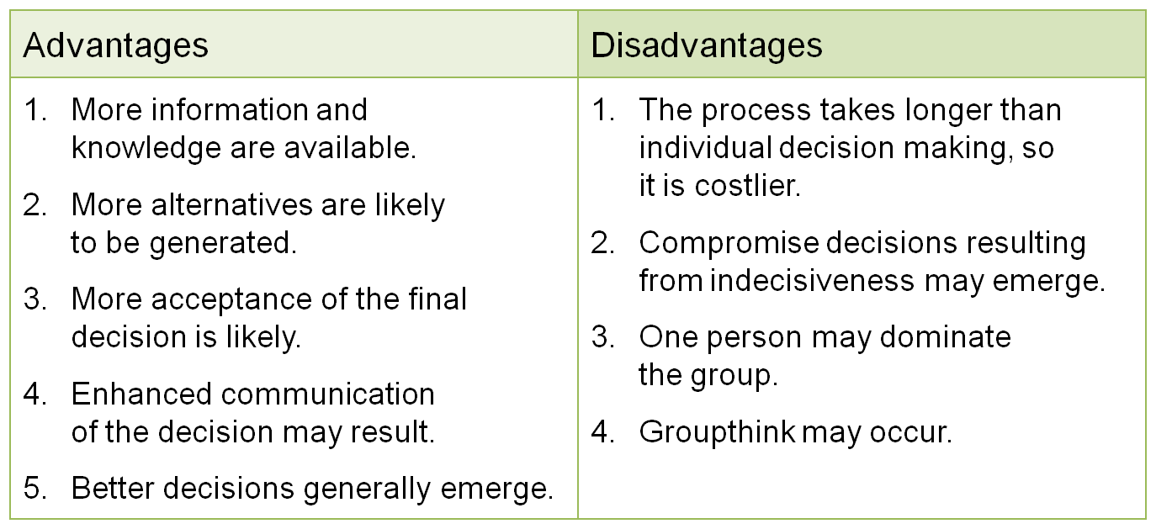
Table 8.2
Advantages and Disadvantages of Group and Team Decision Making
Groupthink occurs when a group or team’s desire for consensus and cohesiveness overwhelms its desire to reach the best possible decision.

Slide 19
Managing Group and Team Decision-Making Processes
Be aware of the pros and cons of group decision making.
Set a deadline for the final decision.
Effective managers can avoid dominance by a single member.
Avoid groupthink by having each member critically evaluate all alternatives.

Slide 20
Summary
The text began with a discussion on the nature of decision making.
Followed by a description of rational perspectives on decision making.
Behavioral aspects were introduced and discussed.
The chapter concluded with a discussion on group and team decision making.

