Slide 1
NIKE, Inc.
Nsedu U. Onyile
Fabiola Mbenkum
Karla Castellanos
Jerrod Motton
New Mexico Highlands University

Slide 2
Mission statement
Nike’s Mission is “To BRING INSPIRATION AND INNOVATION
TO EVERY ATHLETE* IN THE WORLD.”
*IF YOU HAVE A BODY, YOU ARE AN ATHLETE. - Nike co-founder, Bill Bowerman
Notes:
karla

Slide 3
background
Nike’s forerunner was Blue Ribbon Sports (BRS). Started by Philip H. Knight in 1962.
Became a partnership in 1963 with Bill Bowerman.
In 1964, BRS grossed $8,000 with 1,300 sales - it’s first year.
In 1968, the company was incorporated as BRS, Inc.
In 1971, using financing from the Japanese trading company Nissho Iwai
Corporation, BRS was able to manufacture its own line of products overseas.
In 1971, the company introduced its Swoosh trademark and the brand name Nike,
‘the Greek goddess of victory’. Their new symbols were initially put on soccer shoes,
the first Nike product to be sold.
In early 1986, Nike announced expansion into a number of new lines, including
casual apparel for women, a less-expensive line of athletic shoes.
Notes:
karla

Slide 4
Company overview
NIKE, Inc. is the world’s leading sports footwear and apparel company
Nike sells shoes, apparel, equipment, and accessories for a wide range of sport activities,
such as basketball, football, soccer, running, fitness training and lifestyle.
Nike sells its merchandise through over 750 company owned stores and to other retailers.
Nike has other major brands such as Converse, Jordan and Hurley.
Nike generates about 55% of its annual revenue from sales outside the United States.
Notes:
karla

Slide 5
leadership
Founders of NIKE, Inc. are Bill Bowerman & Philip H. Knight
Philip Knight is also the Chairman Emeritus
Mark Parker: Chairman, President and CEO, NIKE, Inc.
Trevor Edwards: President, NIKE Brand
Andy Campion: EVP, Chief Financial Officer
David Ayre: EVP, Global Human Resources
Michael Spillane: President, Product & Merchandising
Hilary Krane: EVP, Chief Administrative officer & General Counsel
John Slusher: EVP, Global Sports Marketing
Eric Sprunk: Chief Operating Officer
Notes:
Karla/Nsedu

Slide 6
Organizational culture
NIKE, Inc. has an integrative culture
Nike has a well-defined and thorough Code of Ethics
“Nike has an organizational culture that encourages human resources to behave in ways that
address business objectives. Training programs are designed to uphold such corporate culture
that aligns with the Nike brand image for sports footwear, apparel and equipment.”
Nike is known for cutting-edge sports shoes, apparel and equipment.
NIKE, Inc. maintains a talented, diverse and inclusive corporate culture
Notes:
Karla/Nsedu

Slide 7
Company profile
NIKE, Inc. trades on the New York Stock Exchange (NYSE)
Ticker Symbol: NKE
2016 Total Revenue: $33.52 Billion
2016 Net Income: $3.89 Billion
Market cap: $95.30 Billion
(04/26/2017 end) Price/share: $55.16
Shares Outstanding: 1.33 billion
EPS $2.70
Return on Equity: 30.22%
Number of Employees: 70,700
Notes:
karla

Slide 8
COMPANY PORTFOLIO
The brands include: the Nike brand, the Jordan brand, Hurley and Converse Inc.
Each brand has its distinct style and addresses a different style and customer base.
NIKE
JORDAN
HURLEY
CONVERSE
- Sports shoes.
- Athletic accessories.
- Athletic apparel.
- Athletic training wear.
- Basketball shoes.
- Athletic shoe.
- Athletic apparel.
-Athletic training
accessories.
- Casual everyday
sneakers.
- Casual accessories.
- Casual apparel.
- Casual everyday
sneakers.
- Casual accessories.
- Casual apparel.
Notes:
karla

Slide 9
Sociocultural forces
- Trends
- Economy
- Ethics
- Trade and Shipment Laws
- Technology
Nike’s business performance depends on the state of the economy of where its products are sold
Notes:
karla

Slide 10
Technological influences
The new Nike HyperAdapt 1.0.
Mercurial soccer cleat.
Nike has eliminated the need for the traditional foam midsole. Instead, the upper is placed directly on top of flexible, ‘pillowy’ air bags, which run the length of the shoe.
- Nike app.. - Nike free
- Nike Aeroloft - Nike Hyperfuse
- Nike Air - Nike Max Air
- Nike DRI-FIT - Nike Shield
- Nike Dynamic fit - Nike Shox
- Nike flyease - Nike storm fit
- Nike flyknit - Nike Therma Fit
- Nike Flywire - Nike Zoom
Notes:
karla

Slide 11
ECONOMY
-The companies recorded revenue increased 10.1% from 2014-2015
-The companies operating profits increased 13.5% from 2014-2015
-The companies net profit increase 21.5% from 2014-2015
The company shows a steady increase in revenue over the years, with dedicated marketing efforts.
Notes:
karla

Slide 12
SWOT analysis
Strengths
Weaknesses
Strong Financial Performance
Geographic Diversification
Wide Manufacturing Base
Lawsuits
US Strategic Initiatives Product
Innovation Increase in Counterfeit Products
Exchange Risks
Expansion by Competitor
Expanding Retail Market in the US
Strategic Initiatives
Product Innovation
Opportunities
Threats
Notes:
Fabiola

Slide 13
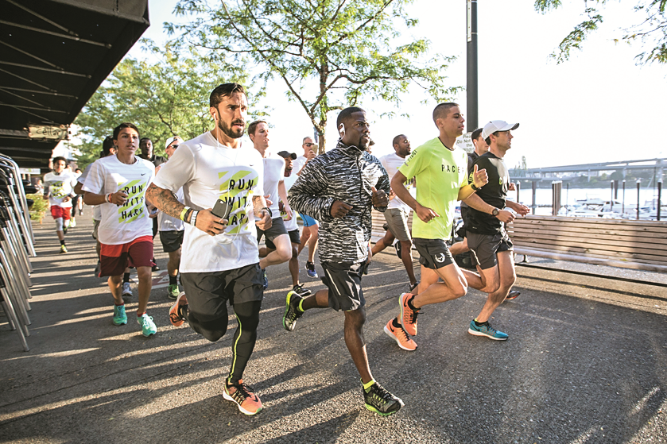
Marketing mix & strategy
Price
- Determine the price by which product is being sold, due to the many operations they operate
Product
- Nike focuses on shoes, athletic gear, apparels and various sporting goods
Place
- Nike has location facilities in over 200 countries, where they produce some products and their customer service reps
Promotion
- social media, celebrities, commercials , and TV
Notes:
Picture: Product – full Nike gear – clothes, shoes, watch/heart rate monitor, caps, socks. Jerrod
Promotion: Kevin Hart – celebrity.

Slide 14
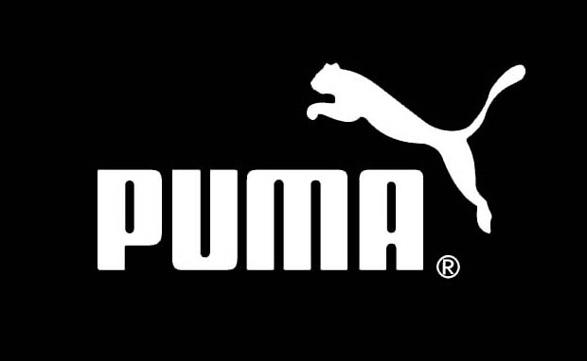
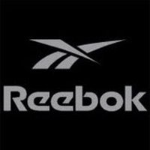
Competitive strategy
NIKE Inc.
Market leader
Notes:
Nsedu

Slide 15
Differentiation strategy
Broad market target
Differentiation rather than Low cost
Broad Differentiation Strategy
+
=
Differentiation by:
Men
Shoes
Nike
Women
Accessories
Jordan
& Various sports and Activities
Boys
Apparel
Converse
Girls
Hurley
Notes:
Nsedu

Slide 16
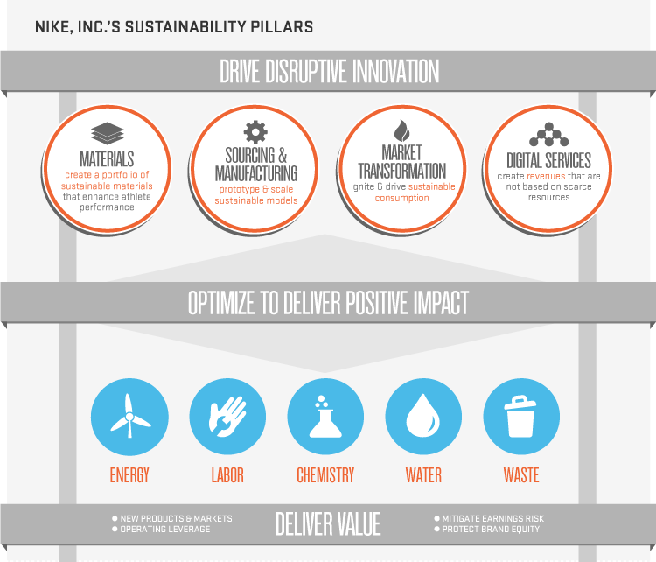
Sustainable innovation
GOAL: Minimize Environmental Footprint, Maximize Performance
Notes:
Nsedu

Slide 17
Notes:
Nsedu

Slide 18
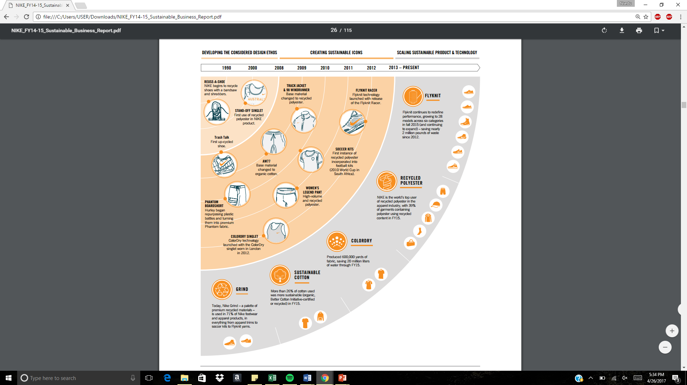
Notes:
Nsedu

Slide 19
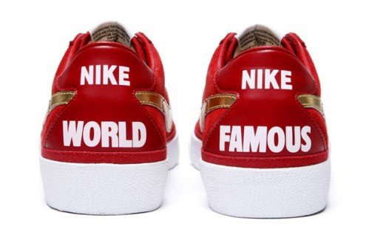
International competing strategy
Distribution through over 100 countries plus thousands of retailers
Production prices at a low cost and raise the price when selling is their main strategy
Focusing on consumers needs and wants
Focusing on their main consumers which the mid-teens in athletics
Notes:
Jerrod

Slide 20
Ethics
They work to reimage the role of waste and renewable energy
Disrupt how people think about their water footprint, and rethink chemistry
In 2015, 54 million pounds of factory waste was transformed into premium materials that was used
in Nike performance footwear and apparel
The use lower-impact, high volume materials- such as recycled polyester and certified Better Cotton
Developing new low-carbon impact materials that turns waste into new materials
Notes:
Fabiola

Slide 21
conclusion
NIKE’s operations are very in line with its mission.
Innovation and technology are key drivers in the company’s success.
Success with sustainable innovation!
* The company revolves around its customers.
Notes:
Nsedu

Slide 22
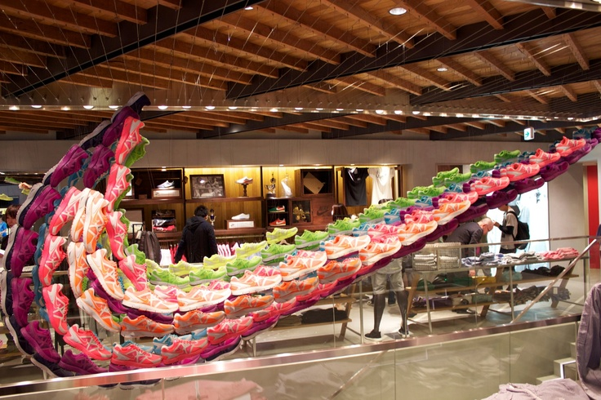
THANK YOU !

