Slide 1
Sears Holdings Corp.
By Tricia Graffeo, Logan Hanhardt, Dalaney Cummins
Notes:
Introduce the team. We chose Sears Holdings Corp because they are very publicly struggling. It is a story we have each seen in the news lately. As a publicly traded company we knew it would be easy to find a lot of information and analysis on their struggles.

Slide 2
Vision Statement
Sears Holding is committed to improving the lives of our customers by providing quality services, product, and solutions that earn their trust and build lifetime relationships.

Slide 3
Mission statement
To grow our business by providing quality products and services at great value when and where our customers want them . And by building positive and lasting relationships with our customers.

Slide 4
Strengths
Well established- Sears Holdings is a household name that has been a nationwide presence for years
Founded in 1886 opened retail locations in 1925
Locations in all 50 states
Puerto Rico, Guam, Canada and Mexico
18th largest retailing company in the United States as of 2014
They own popular specialty brands (about 47)
Kenmore
DieHard
Sold Craftsmen- 900 million
Sesame Street branded children’s clothing
Winnie The Pooh branded children’s clothing
Land’s End
Notes:
Talk about their nation-wide presence and history as a household name.

Slide 5
Weaknesses
Little to no online presence
Bad websites
People have a bad image of Kmart
Kmart brand is perceived as low quality
Already in decline
Notes:
Sears and K Mart both have facebook pages but they are not managed well and they post very boring posts.
It’s not a facebook you WANT to follow, it’s a facebook you would look up to complain.
Their wesites are slow, dysfunctional, and not user friendly at all. They are also unappealing to the eye.
A lot of the K Marts are older building that have never been updated, they are poorly lit, overstalked and hard to get around.
They sell a lot of low quality/inferior items.
The company has been struggling for years and it has been broadcast very publicly. People know they are declining and that can deter customers from coming in.

Slide 6
Opportunities
Increase social media presence
Improve websites and internet sales process
Remodel and improve physical stores
Revamp products
Publicize improvements
Better training for staff
Specialize training for staff in specific areas
Notes:
Create social media personality, like Wendy’s. They need to create a plan for posting more interesting content and handling negative comments in a professional and timely matter. Be more interactive.
Make the websites better to look at, make them more user friendly, and easier to navigate. Fill their main page with trending and appealing items. Better customer service and assistance for people who have already placed order.
As Sears and KMArt have been around for a very long time their stores are older and need to be updated.
Revamp products
Once they make these changes its important that they let the public know
As part of the overall rebranding of Sears we believe its important for their frontline employees to show the same level of improvement.

Slide 7
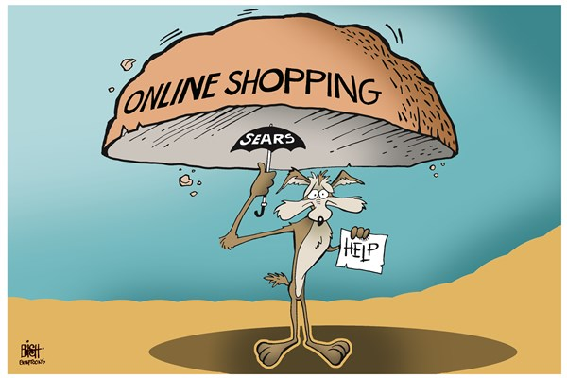
Threats
E commerce giants (like amazon) own so much market share
Other big box stores

Slide 8
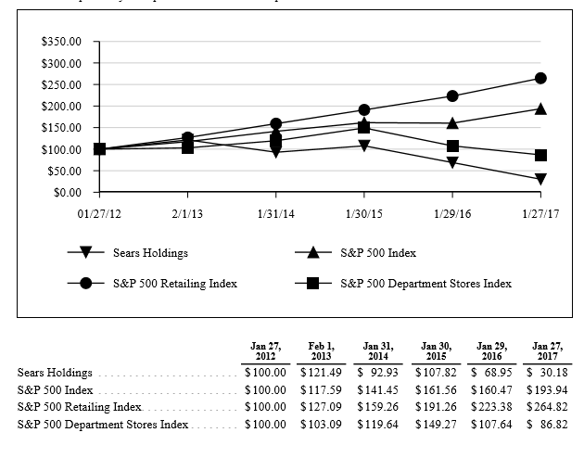
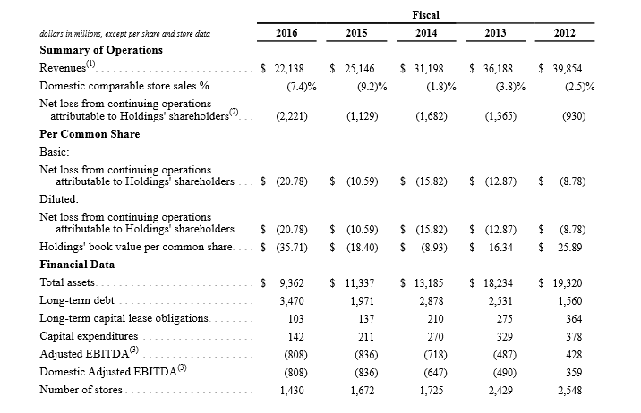
Financial Statements
Notes:
Over the last 5 years Sears has drastically declined as compared to the S and P Index. Sears has operated at a net loss and accumulated large amounts of debt.

Slide 9
Analysis
Debt to Equity Ratio - (-3.45)
Current Ratio - 1.07
Gross Profit Margin Ratio - (-0.09)
Asset Turnover Ratio - 2.36
Notes:
Debt to equity is negative which is BAD, this is caused by a negative retained deficit.
Their current ratio is above one which is good, but it could probably be higher.
Their gross profit margin is bad. They need to increase their gross profit margin.
Their asset turnover ratio is consistent with the industry average.

Slide 10
Recommendations
Hire a team to revamp websites and PR
Hire a team to help improve online advertising and social media presence
Outsource the remodeling of stores
Improve quality of merchandise
Create a top down employee training program
Promote innovation
Notes:
WE believe the most effeicient way to make these changes would be to hire a professional team of PR experts and advertising experts. They should have a designated gourp of employees with a cohesive plan to manage their social media accounts.
They need to come up with a process to test products and review them so they can offer products of higher quality. And stop carrying products that will weigh down their brand image
They need to create a design concept for all of their stores and then hire a team to go through and remodel the profitable stores that they have chosen not to close.
The new training program should require sales employees to choose an area of interest to become experts in their own departments. This will offer the customer confidence in their purchase and a reason to come back for more products and further expertise.
In order for these changes to be effective the public must know about it. A good way to accomplish this is to use their new and improved online presence to promote their new image. They should also offer sales and a grand reopening.

Slide 11
Summary
We believe that by improving Sears Corp’s online presence, stores, staff, and products the corporation could see significant growth in both sales and market share.

Slide 12
References
https://www.bloomberg.com/news/articles/2017-02-10/sears-soars-on-plan-to-cut-debt-pension-burden-by-1-5-billion
https://www.usatoday.com/story/money/business/2017/03/21/sears-says-substantial-doubt-can-stay-business/99479726/
https://www.nytimes.com/2017/03/30/business/edward-lampert-sears-kmart.html? r=0
https://www.usatoday.com/story/money/business/2017/03/21/sears-says-substantial-doubt-can-stay-business/99479726/
https://www.nytimes.com/2017/03/30/business/edward-lampert-sears-kmart.html? r=0

