Slide 1
The Company
Robin Sena, Jennifer Gallegos, T.J. Potter and Tawny Armenta

Slide 2
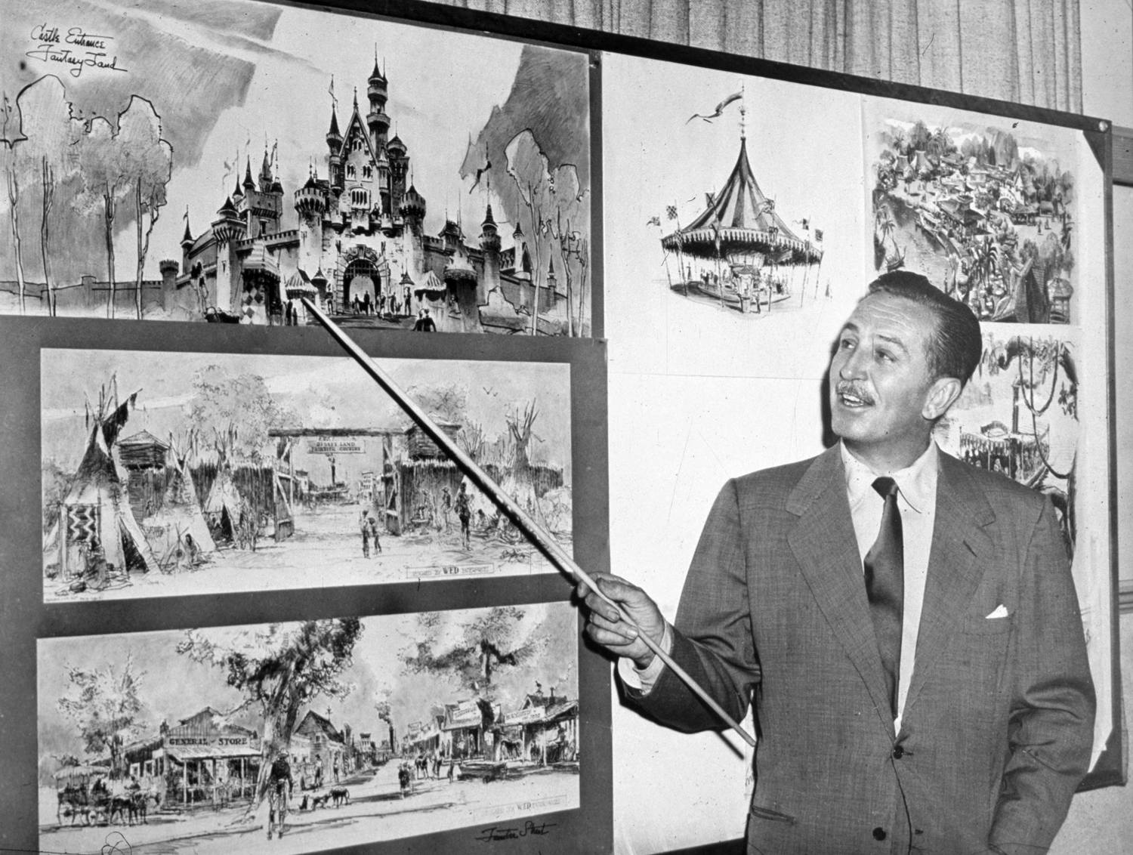
Mission Statement
“The mission of The Walt Disney Company is to be one of the world’s leading producers and providers of entertainment and information. Using our portfolio of brands to differentiate our content, services and consumer products, we seek to develop the most creative, innovative and profitable entertainment experiences and related products in the world.”
– The Walt Disney Company

Slide 3
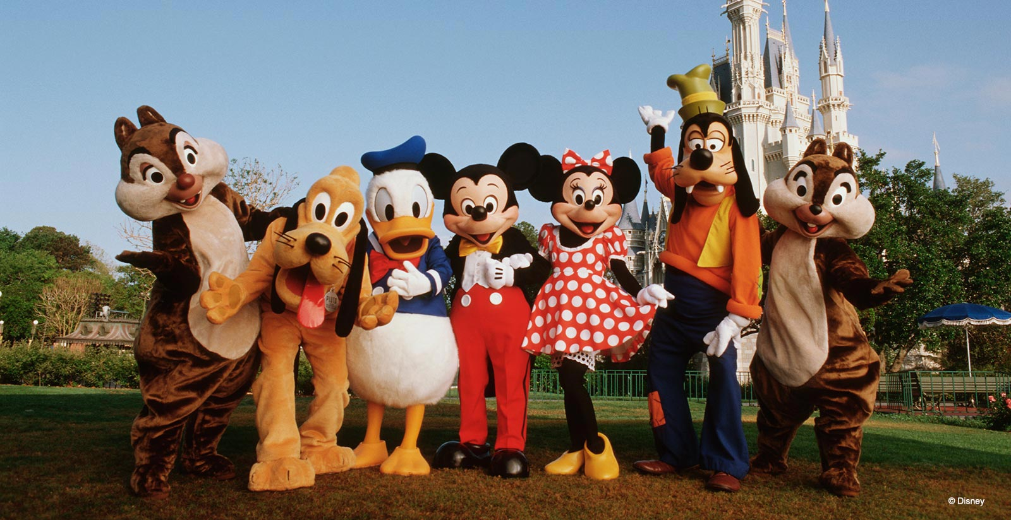
Company Overview
The Walt Disney Company, along with its subsidiaries and affiliates, is a leading family entertainment enterprise.
Operates though 4 business segments:
Media Networks, Parks & Resorts, Studio Entertainment, and Consumer Products & Interactive Media
Sector
Consumer Services
Industry Media
Conglomerates
Market Cap
$154.5 B

Slide 4
History of Disney
1923
The Walt Disney Company begins. First known as the Disney Brothers Cartoon Studio
Disney Channel starts broadcasting
1971
1929
1940
1955
The Disney brothers partnership is replaced by four companies: Walt Disney Productions, Walt Disney Enterprises, Liled Realty, and Investment Company, & the Disney Film Recording Company
Walt Disney issues its first stock
Disneyland opens
Walt Disney World opens
1983
1986
Walt Disney Productions name changes to The Walt Disney Company
1987
The first Disney store opens in Glendale, CA
1996
Stockholders approve Disney merger with Capital Cities/ABC
2005
Robert A. Iger becomes Chief Executive Officer of The Walt Disney Company

Slide 5
Disney’s Leadership
Robert Iger Chairman & CEO
Andy Bird Chairman, Walt Disney International Walt Disney Company
Alan Braverman Senior Exec. Vice President, General Counsel and Secretary Walt Disney Company
Bob Chapek Chairman, Walt Disney Parks and Resorts
Alan Horn Chairman Walt Disney Studios
Ronald Iden Senior VP Global Security Walt Disney Company
Kevin Mayer Senior Executive VP and Chief Strategy Officer Walt Disney Company
Christine McCarthy Senior Executive VP and Chief Financial Officer Walt Disney Company
Zenia Mucha Senior Executive VP and Chief Communications Officer Walt Disney Company
Jayne Parker Senior Executive VP and Chief Human Resources Officer Walt Disney Company
James Pitaro Chairman, Disney Consumer Products and Interactive Media
Ben Sherwood Co-Chair, Disney Media Networks and President, Disney/ABC TV Group
John Skipper President, ESPN and Co-Chairman, Disney Media Networks
Brent Woodford Executive VP, Controllership, Financial Planning and Tax

Slide 6
Board of Directors
Robert Iger
Robert Matschullat
Mark Parker
Sheryl Sandberg
Orin Smith
Aylwin Lewis
Susan Arnold
Mary Barra
John Chen
Jack Dorsey
Maria Lagomasino
Fred Langhammer

Slide 7
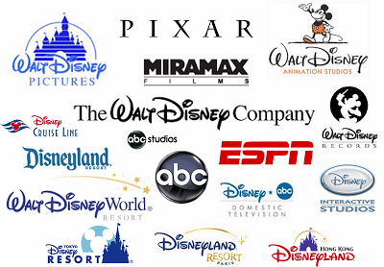
Internal Environment
Strengths:
Strong Brand Name/Image throughout the world
Diverse Portfolio
Leadership position in entertainment industry
Strong financial performance
Weaknesses
Business seasonality (media networks, parks)
Heavy dependence on US and Canada markets
Target Market
Children, teenagers and families.
Corporate Citizenship

Slide 8
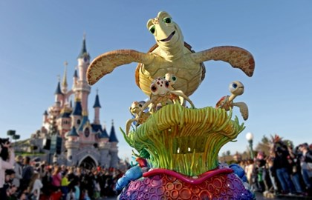
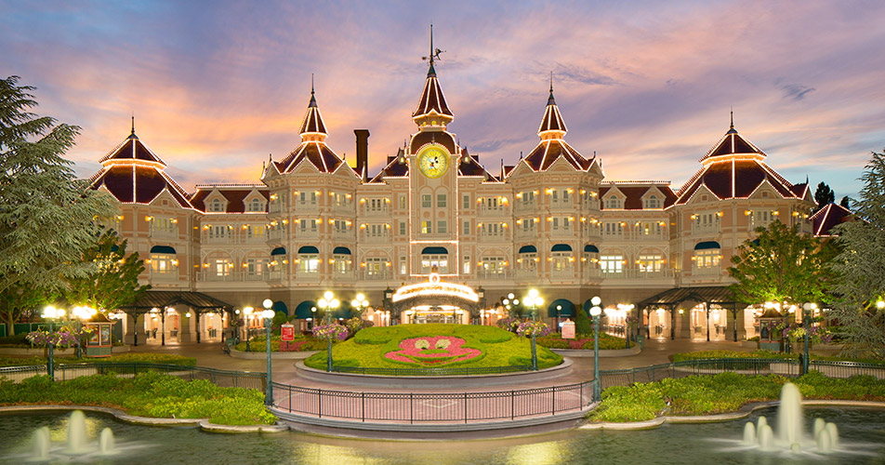
External Environment
Opportunities
International expansion
Shift to online media and entertainment
Threats
Heavy competition
Loss of Network subscribers

Slide 9
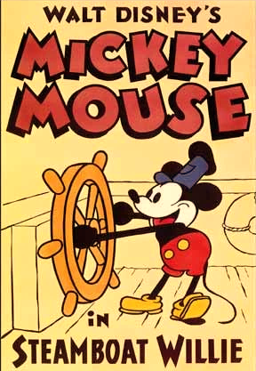
Disney Studios
The Walt Disney Studios is the foundation on which Walt Disney built his company.
Started in 1923
Mickey Mouse was “born” in 1928.
In 1937 Disney released it’s first full-length film, Snow White and the Seven Dwarfs.
Today, Disney Studios produces quality movies, plays, and music to consumers throughout the world.

Slide 10
Parks and Resorts
As Walt’s films and TV programs became successful he felt a desire to continue to grow. He secretly purchased over 200 acres of orange groves in Anaheim, CA which became the site of Disneyland.
Disneyland was inspired by Walt’s two daughters. He felt like there should be a place where parents and children could go and enjoy themselves together.
Today, year after year millions of guests around the world choose Disney Parks and Resorts as a top vacation destination.
Short tribute to Disney's parks, resorts and cruise line.

Slide 11
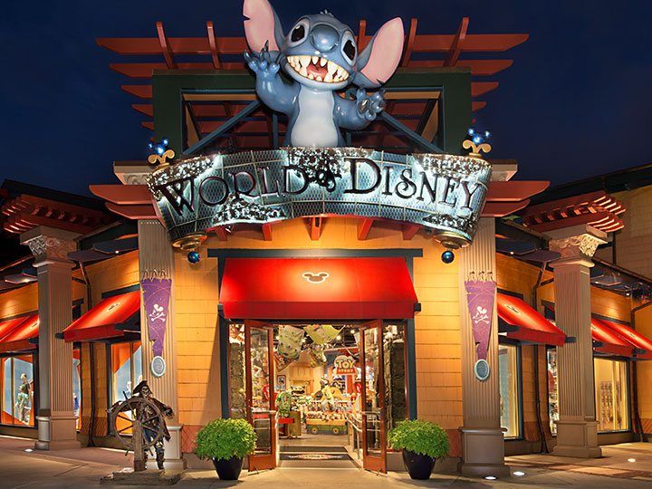
Products and Services
Parks and Resorts
Disneyland
Walt Disney World
Shanghai Disney Resort
Disneyland Paris
Tokyo Disney Resort
Hong Kong Disneyland
Aulani
Disney Cruise Line
Bob Iger on the Success of Disney
Studio Entertainment
Walt Disney Studios
Pixar
Marvel Studios
Lucas Film
Disney Nature
Media Networks
Disney Channel
ABC
ESPN
Disney Customer Products and Interactive Media
Disney Store
Disney Publishing

Slide 12
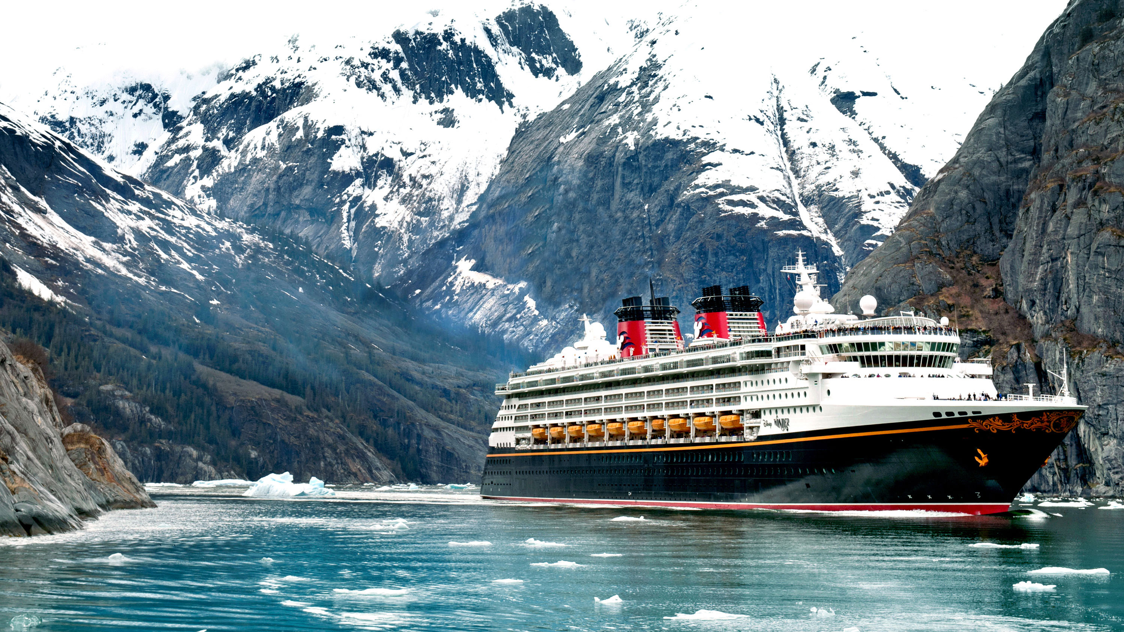
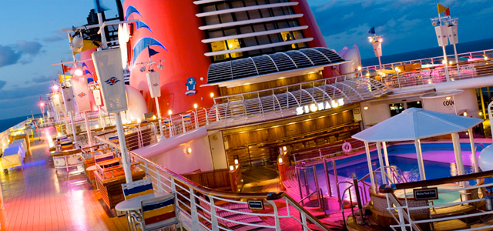
Disney Cruise Line
Cruise Destinations:
Bahamas
Caribbean
Europe
Norwegian Fjords
Mediterranean
British Isles
Bermuda
Alaska
Canada
Mexico
Panama Canal
California’s Coast, and many others

Slide 13
Current Position
Stock Price / NYSE: DIS - Nov 27, 6:05 PM EST 102.79USD 0.15 (0.15%)
Market Capitalization (Millions $) 158,913
Shares Outstanding (Millions $) 1,546
Employees 180,000
Revenues (TTM) (Millions $) 55,137
Net Income (TTM) (Millions $) 9,366
Cash Flow (TTM) (Millions $) 0
Capital Exp. (TTM) (Millions $) 3,623
Video on Disney Company Stock

Slide 14
Recommendations
Continue upgrades to the parks and resorts.
Add more parks and resorts to other countries and states.
Build resort in Alaska, taking advantage of increased tourism and interest there.
Expand in emerging economies such as Brazil, Russia and India.
Increase accommodation size at parks and resorts to accommodate more consumers.
Expand its acquisition of programming rights.
Expand streaming services.
Offer different television shows, such as cooking and behind-the- scenes.

