Slide 1


Slide 2
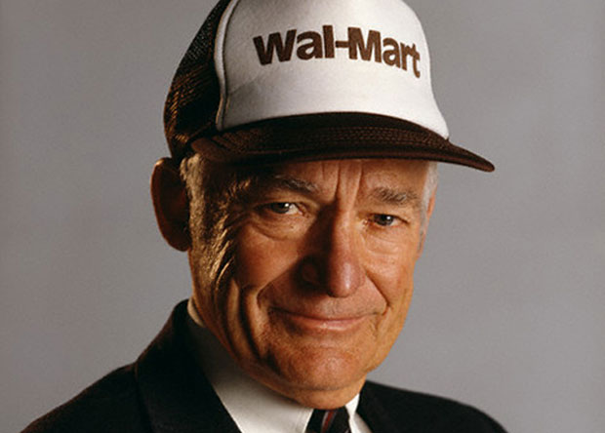
“ The secret of successful retailing is to give your customers what they want. And really, if you think about it from your point of view as a customer, you want everything: a wide assortment of good-quality merchandise; the lowest possible prices; guaranteed satisfaction with what you buy; friendly, knowledgeable service; convenient hours; free parking; a pleasant shopping experience.”- Sam Walton (1918-1992)

Slide 3

Business Description
Wal-Mart is the largest retail company in the world. At the end of FY2012, Wal-Mart operated 10,130 stores across 27 countries.
Wal-Mart operates through three business segments: Walmart US, Walmart international and Sam' Club.
Walmart international’s retail operations are supported by 158 distribution facilities located in Argentina, Brazil, Canada, Chile, China, India, Costa Rica, El Salvador, Guatemala, Honduras, Japan, Mexico, Nicaragua, South Africa and the UK,
Walmart US operates four different retail formats in the US: supercenters, discount stores, neighborhood markets and other small formats.

Slide 4
Historic LANDMARKS
Wal-Mart was established in 1969. In 1972 was listed on the New York Stock Exchange
Wal-Mart entered Mexico with opening of Sam’s Clubs in 1992 in joint venture with Mexico’s largest retailer Cirfa.
It acquired 122 former Woolco stores in Canada. (1994)
In 1996 Wal-Mart continued to expand internationally opening stores in China
The company became the first nationwide US grocery store to adopt Global Food Safety Initiative (GFSI) standards in 2008
In 2009 Wal-Mart partnered with FIFA to operate 2010 FIFA World Cup Official Event Store in nearly all of its retail markets around the world
In 2011, Wal-Mart announced to install solar panels on about 60 stores in Cali. Expanding the companies portfolio to 75% of its stores in State. 2013 the company plans to install more than 130 stores throughout the state.

Slide 5
Services

Slide 6
Retail mix
Retail Strategy
Customer Service
Location
Merchandise
Assortment Pricing Communication Mix
Store Design& Display

Slide 7
Customer Satisfaction
Good Quality
Good Value
Good Serviced
Customer Satisfaction

Slide 8
3 basic beliefs
Respect for the Individual
Service of Customers
Strive for Excellence

Slide 9
Customer-Centric Policies
Wal-Mart's pricing policies: consumers always wanted the best bargain on the products purchased by them without compromising on the quality.
Walton had used the captions -"We Sell for Less" and “Satisfaction Guaranteed" on the very first Wal-Mart signboard.
Wal-Mart followed concept of Every Day Low Price (EDLP)policy.
The main policy: Wal-Mart would always provide a wide variety of high quality, branded and unbranded products at the lowest possible price, offering better value for the customer's money.
Their belief: Because you work hard for every dollar, you deserve the lowest price we can offer every time you make a purchase.

Slide 10
The Service Philosophy
•Half price
•The price goes down, the more customers buying the products
•Every Day Low Price
•Rollback
•Special Buy

Slide 11
Service Strategy
Services must have: High responsiveness, Timely, Accurate in speed and quality in fast time, every time and last time
Increases its employee productivity
Replenish shelves up to three times faster
Keep proper track on the products
Low inventory cost
Make customer happy

Slide 12
Services at store
Separate podiums are being set up in the middle of the main isle behind the cashier area for customer queries.
Photo gift card service - The capability to place a personal photo, business card and phrases on the front of a gift card – plus the option to recharge the card at local Wal-Mart
Great return policy…

Slide 13

Returning Policy
100% Guaranteed
•Everything is returnable.
•Items can be returned through mail.
•To return computers, hardware or perishable items, call Wal-Mart.
•Exchanging items are also allowed.

Slide 14
Products
Groceries
Books
Automotive
Shoes
Arts and Crafts
Housewares
Electronic
Family Apparel
Health and Beauty aids
Toys
Fabrics
Lawn and Garden
Jewelry
Pharmacy
Vision Center
One-Hour Photo

Slide 15
Services
Shipping Services
Trial Offers
Pharmacy Services
Credit Card Services
Photo Center
Internet Services
Vacation
Gift Registry
Social Services
Return Policy
Personalized Gift Cards

Slide 16
Site-to-store program
This program allows customers to shop for thousands of products at www.walmart.com
Most of those products which are not available in stores and have their purchase shipped for free to Wal-Mart stores nationwide, excluding Alaska, Hawaii and Neighborhood Markets.

Slide 17
RV Travelers parking
Wal-Mart values RV travelers and considers them among our best customers.
Consequently, they permit RV parking on their stores.
Permission to park is extended by individual store managers, based on availability of parking space and local laws.

Slide 18
Service for disables
Wal-Mart Stores, Inc., is committed to making reasonable modifications to its policies, practices, and procedures to permit the use of service animals by its customers ensuring the independence of people with disabilities.

Slide 19
Use of it for services
-ASDA
Wal-Mart uses computers to help further educate and to train their employees.
Wal-Mart’s 1.2 million employees in the U.S. are offered e-learning programs to help develop their personal skills.
Using this information technology Wal-Mart offers classes that help to increase productivity at both work and in employee’s personal lives.
Wal-Mart’s e-learning training includes times management and goal setting courses.
In the United Kingdom. Wal-Mart owned, ASDA stores also offer e-learning.
ASDA not only offers e-learning for its store employees but also to their 1,800 employees who work at their headquarters

Slide 20
Helping People Make a difference
Wal-Mart doesn’t only help their customers at their stores but they do help their customers with their life.
•Provides scholarships
•Helps children’s hospitals
•Provides money to fund raisers
•Cares about environment

Slide 21
SWOT ANALYSIS
Strengths
Weaknesses
Market Leader with unprecedented scale and wide product assortment.
Low cost leadership enables Wal-Mart to offer products at low points
Internationalization strategy a strong foundation for growth as the US market matures
Litigations affect labor relations adversely.

Slide 22
SWOT ANALYSIS
Opportunities
Threats
Outperformances of the retail sectors in emerging markets
Concentration on grocery and food will benefit as eating at home, and health and wellness trends continue to grow
Growth in internet retailing to serve larger market
Increasing acceptance of private label merchandise.
More than 2 million employees increase exposure to rising wages and high healthcare costs
Intensifying competitive pressures from different channels.

Slide 23
Market Analysis

Slide 24
“If you build it they will come…but only if you do great marketing.”
-Brad Sugars

Slide 25
Overview
Physical sales of approximately $466billion in 2013
Retail stores in 27 countries
Ecommerce website in 10 of the countries

Slide 26
Value proposition
Low Prices
Variety in Product Selection
Convenience

Slide 27
Target Customers
Working class families and individuals

Slide 28
Positioning
Low-Cost leader when compared to its competitors
Low Cost Alternatives
Great Value
Partnerships
  Local Banks, (e.g. UrbanParnetshipBank, Chicago), Fast food restaurants, etc.

Slide 29
Marketing Mix
Product
Variety in selection
Services through partnerships with
Groceries
Movies
Crafts
Gifts
College Essentials
Electronic items
Home Appliance
Jewelry
Photo Center
Toys
Outdoor Living
Video Games
Restaurants: McDonalds and Subway
Banks

Slide 30
Marketing Mix
Price
Lower cost than competitors
Price matching
Great Value (lower cost alternatives)
Value Bundles
  Clearance
Rollbacks

Slide 31

Marketing Mix
Place
11,000 stores across 27 countries
Operates under 69 banners
E-commerce websites in 10 countries
Walmart stores include :
  Discount Stores
  Super Centers
  Neighborhood markets
  Express stores
  Sam’s club warehouses

Slide 32

Marketing Mix
Promotion
ON-LINE
&
OFF-LINE
Main website
twitter
Facebook
YouTube

Slide 33
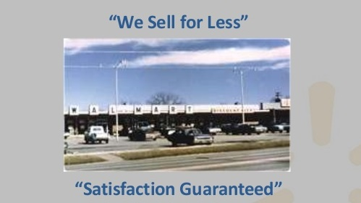
First Two Ads

Slide 34
Walmart Home Web-site
Opt-in emails
Relevance (depending on how you browse or shop)
Cyber week deals (e.g. 200 deals on its website each day through Friday, plus free shipping on all orders over $35)
Value of the day (best deal of the day)
Weekly ads

Slide 35
Last Post: Today
Last Post: Today
As of November 21, 2013

Slide 36
YouTube
As of November 21, 2013

Slide 37
Twitter
As of November 21, 2013

Slide 38
Human Resource

Slide 39

“As the world’s largest retailer, we depend on our HR team to understand the connection between fitting the right person to the right job and our broader mission of improving lives. We look to our HR associates to motivate and empower associates, ensuring that every single member of our team feels uniquely fulfilled, challenged and capable of successfully completing the day-to-day operations.”
WALMART
CAREER GROWTH VIDEO

Slide 40
Working at Walmart
Sam Walton said, “Our people make the difference.” Working at Walmart means opportunity for you and your career. What does Making Better Possible mean? Well, for tens of thousands of people every year, a job at one of our Stores or Clubs opens the door to a better life. Working to save customers money in new and better ways.
Employs 2.2 million associates globally
Provides roughly 300 jobs every time a Supercenter opens
In 2012, women accounted for 53% of hourly promotions in U.S. stores
About 75% store management teams began as hourly associates, and they earn between $50,000 and $170,000 a year
Every year, promoting 170,000 people to jobs with more responsibility and higher pay
Depending on the time of year, there are approximately 15,000 – 50,000 job openings at Walmart
eCommerce recruits entrepreneurs, technologists, data scientists and consumer Internet professionals around the world – with more than 1,500 associates in Silicon Valley, Sao Paulo and Bangalore
The Walmart and Sam’s Club Home Offices are nestled amid the Ozark Mountains in Bentonville, Arkansas — the nation’s 6th fastest growing region

Slide 41
Employee Selection process
STEP 1: The Application
Walmart accepts online applications only.
Potential employees can apply at home (http://jobs.walmart.com/) (http://careers.walmart.com/career-areas/)
OR
Visit any Walmart hiring kiosks usually located by customer service.

Slide 42
Employee Selection process
STEP 2: The Assessment Test
Potential Walmart employees must take a test with scenarios following questions on how they would react and deal with the situation at hand. The scenarios are concerning customers, supervisors, coworkers and just general situations.
Results will score in one of two Tiers. Scores in Tier 1 will be chosen over scores in Tier 2

Slide 43
Employee Selection process
STEP 3: 1st Interview
A group interview of three. Questions concerning pervious jobs and the scenarios referring to the assessment test.
Only one potential employee will be chosen to advance to the final interview

Slide 44
Employee Selection process
STEP 4: Final Interview
In depth questions previously asked in the 1st interview. If passed, are instructions for a drug test and a background check.

Slide 45
Employee Selection process
STEP 5: Orientation/Training
Orientation consists of three days. The first two days are mostly paperwork, videos, and the basics. The last day computer modules will be introduced, called e-training. E-training is a program with various computer modules on a subject matter and is tested at the end of each module. (ex: ‘Alcohol Compliance’)

Slide 46
WALMART HR TEAM
5 divisional HR Leaders
27 regional HR Directors
345 Field HR Managers

Slide 47

WALMART HR TEAM
A five person team of HR professionals with legal backgrounds are available 24 hours 7 days a week to handle supervisors concerns regarding employment matters.

Slide 48

BENEFITS
Our Benefits team works hard to offer associates comprehensive and affordable benefits to help you stay healthy. When you become an associate, you can take advantage of a variety of great benefits for you and your family

Slide 49
Health &well-being
BENEFITS
Consumer-directed health plans, including Health Reimbursement Accounts (HRA) plans and a high deductible plan with a Health Savings Account (HSA). Highlights include:
  100 percent coverage for eligible in-network preventive care
  $4 co-pay on eligible generic drugs at Walmart or Sam’s Club pharmacies
  Free access to nurse care managers and health care advisors
HMO plans (available in certain areas)
Resources For Living® – a free confidential counseling and health information service
Company-paid life insurance
Accidental death & dismemberment insurance (AD&D)
Critical illness insurance
Short- and long-term disability insurance
Business Travel Accident Insurance
Illness Protection (Sick Time)
Associate Eyewear Program

Slide 50
Financial
BENEFITS
Matching contributions to your 401(k) up to 6% of your salary
Associate Stock Purchase Plan with a company match
Associate Discount Card for Walmart and Home Office associates and Sam’s Club Home Office associates, spouses and dependents
Sam’s Club associates receive a complimentary membership
Exclusive discounts on everything from brand new cars and wireless services to travel when associates visit our online Associate Discount Center – more than 375 discounts available

Slide 51
Turnover rate
A high turnover rate is evidence of an unhappy workforce.
Approximately 70% of its employees leave within the first year.

Slide 52
HR issues
Walmart has faced a number of lawsuits and issues regarding its workforce.
Low wages
Its size in the labor market and its low-cost operations place enormous pressure on higher wage competitors to cut their labor costs as well.
Inadequate health care
Many states that offer health-care subsidies to low-income individuals and families have discovered a disproportionate number of participants employed at Wal-Mart. Employees show up on the rolls of other low- income assistance programs as well.
Company’s strong anti-union policies
well-known and aggressive opposition to unionization -- going so far as to close facilities that successfully unionize -- has received attention over the years, and more recently, stories in the press have highlighted various violations of employment laws.
Gender discrimination
Female employees were discriminated against in matters regarding pay and promotions .

Slide 53
Future of Walmart
Planning on making adjustments to target a larger consumer population. A 5 year plan titled the “Next Generation of Walmart”
More aggressive price cuts
Create over 500,000 new jobs by stationing slightly smaller Walmart centers in rural locations to attract and enhance convenience for consumers
Mobile Shopping
Repurchase $15 billion worth of their shares, currently going for $50.40 a piece. Regaining this share control will allow the company to make even larger business decisions; maintaining the presence as a dominant powerhouse in the stock market

Slide 54

Future of Walmart
          “The Next Generation”
          CEO Mike Duke
"As proud as we are of our recent performance, future success is never guaranteed.”
"Walmart must widen the gap as a low-price leader among its competitors. ”

Slide 55
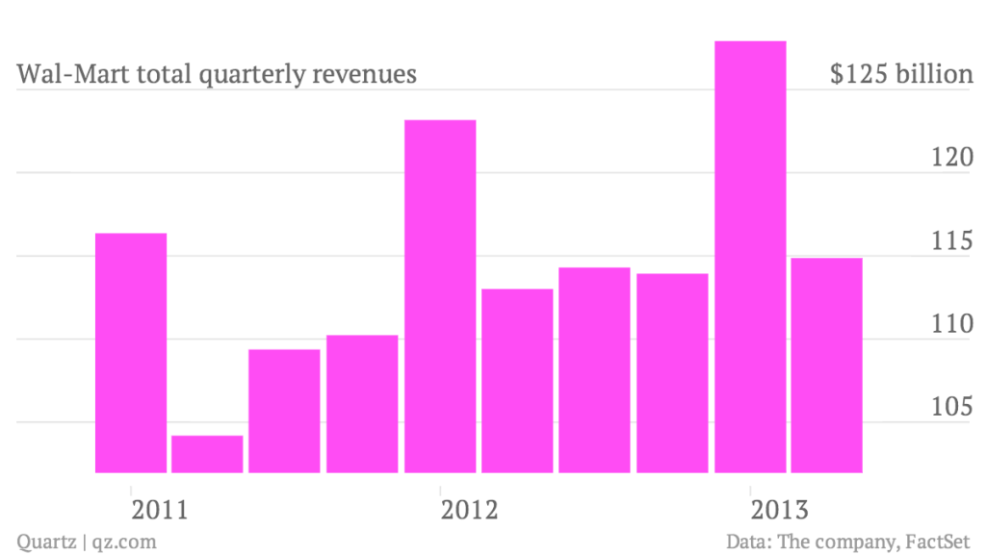
International Growth
International sales have reached over a quarter

Slide 56
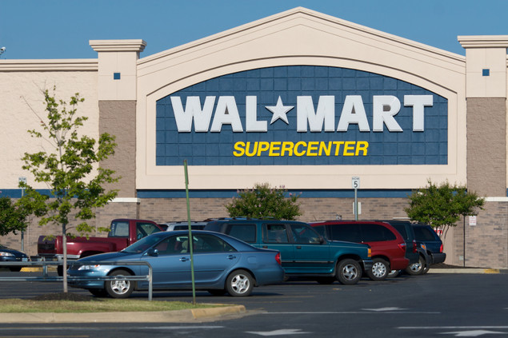
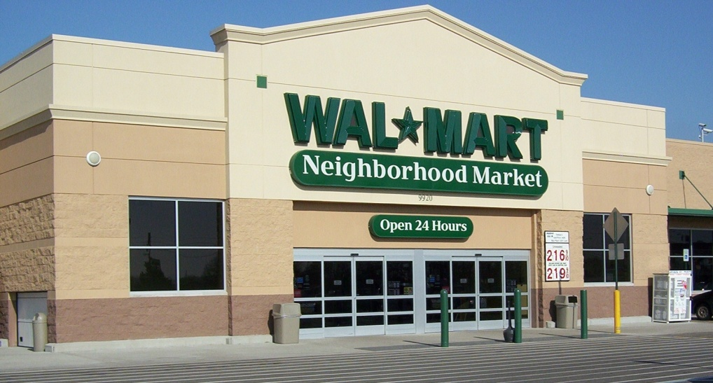
Specializing
To Meet Consumers Needs
Down sizing Walmart Outlets
Attacking Rural Areas
Skilled Employees

Slide 57
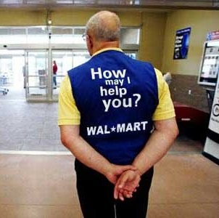
Employee Incentives
The opportunity to show up to work everyday, perfecting a craft that you love
Satisfying
starting wage
Long term career!

Slide 58
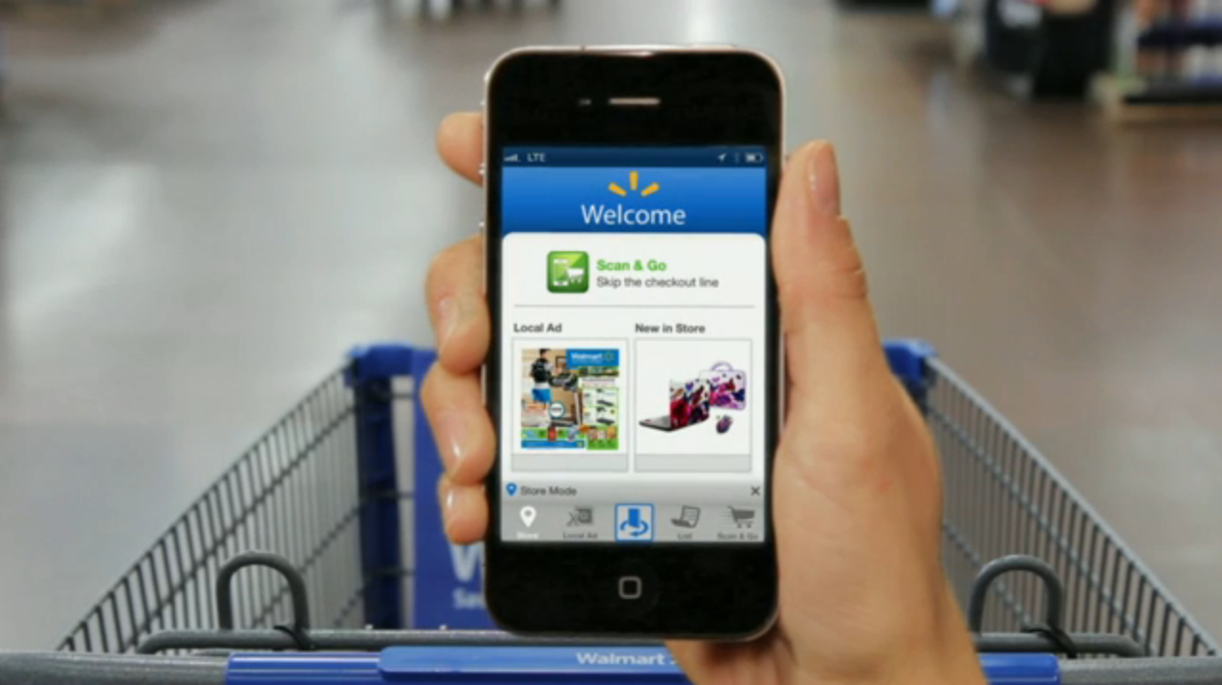
Technological Advancements
Gathering A data base of preferred customers will attract Investors, ultimately raising the overall net worth of the company
Customer Benefits!

Slide 59
Conclusion
Even though Wal-Mart is the pioneer of its industry with about one-hundred million customers entering its stores each week it still continues to rise even further above its competition.
Many still consider Wal-Mart's pioneering, IT-driven supply chain to be the world's most efficient.
The technology aspect of the retail giant has kept Wal-Mart's prices lower than its competition.
Business intelligence helped Wal-Mart cut cost at every stage and achieve their goal of providing their customers with the ability to, “Save money, Live better.”

