Slide 1
IHRM TRENDS & FUTURE CHALLENGES
Chapter 10

Slide 2
IHRM TRENDS & FUTURE CHALLENGES
Chapter 10
Vocabulary
Objectives
Introduction
International business ethics & HRM
Criminalization of bribery
NGOs
Safety, security, & counterterrorism

Slide 3
Vocabulary
ethics
external factors, organizational factors
ethical relativism, absolutism & universalism
bribery
‘gifts’, ‘facilitating’, & ‘grease’ payments
FCPA
TI = Transparency International, Corruption Perceptions Index
NGOs: The Red Cross, The Red Crescent, World Vision, Oxfam, The Fred Hollows Foundation, Médecins Sans Frontieres,
disaster protocols, risk management, ‘critical incidents’
workplace violence, industrial theft
in-house security, in-facility security
industrial espionage, cyber-terrorism
terrorist threats: micro & macro levels

Slide 4
Objectives
We comment on observed trends & future directions:
International business ethics & HRM
Mode of operation &IHRM
Ownership issues relating to IHRM requirements of organizations other than the large multinational, such as non-government organizations (NGOs)
Safety, security, & terrorism issues

Slide 5
Introduction

Slide 6
These are not emphasized in the general IHRM literature:
International business ethics
Mode of operation
NGOs
Emerging role of IHRM in contributing to safety & security and dealing with terrorism

Slide 7
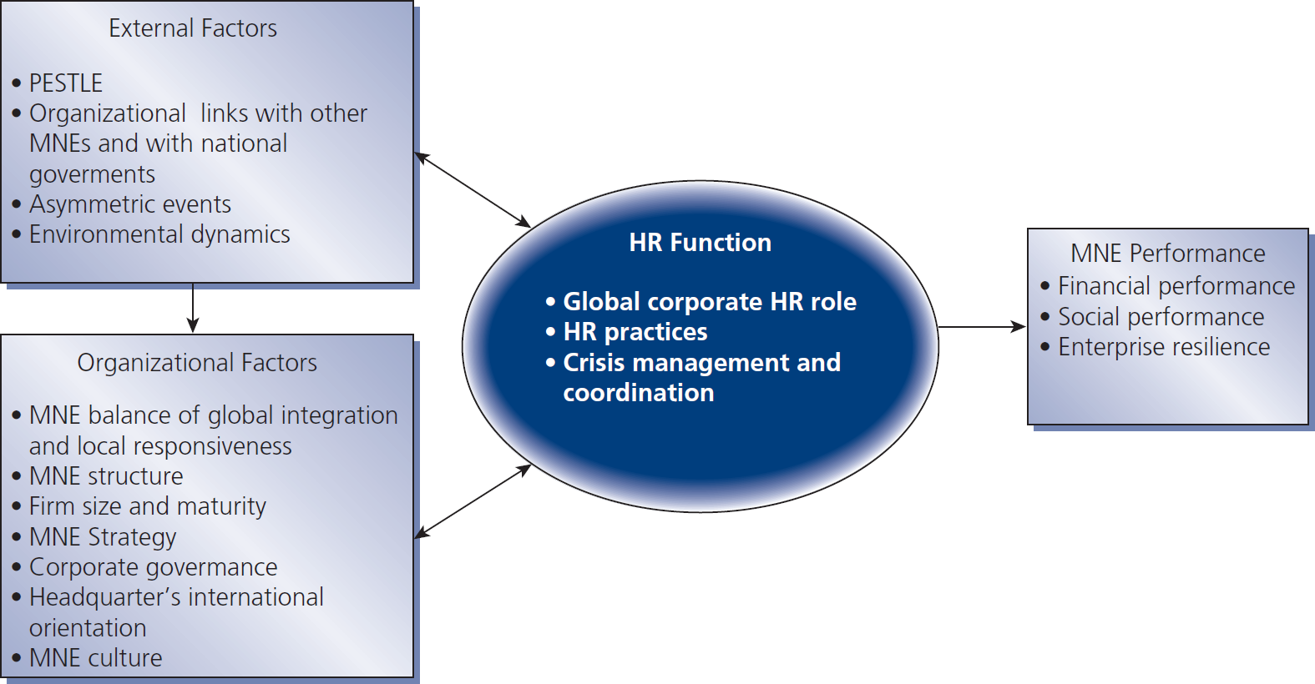
Figure 10.1
A model of strategic HRM in multinational enterprises

Slide 8
International business ethics & HRM

Slide 9
Ethics & IHRM
Ethical relativism no universal or international rights or wrongs
Ethical absolutism one should do what one would do at home
Ethical universalism there are principles of right & wrong which transcend cultural boundaries

Slide 10
Criminalization of bribery

Slide 11
Bribery & corruption in international business
Bribery & corruption is paying agents to do things inconsistent with the purpose of their position or office so as to obtain an unfair advantage
Bribery ≠ “facilitating” or “grease” payments
US Foreign Corrupt Practices Act (FCPA)
OECD Convention on Combating Bribery of Foreign Public Officials in International Business Transactions

Slide 12
NGOs

Slide 13
Non-govt. organizations (NGOs)
Globalization has increased the scale & importance of NGOs
The above trend will likely continue well into the 21st century
Prominent examples of NGOs:
■ Red Cross ■ Fred Hollows Foundation ■ Red Crescent ■ World Vision ■ Oxfam ■ Médecins Sans Frontieres

Slide 14
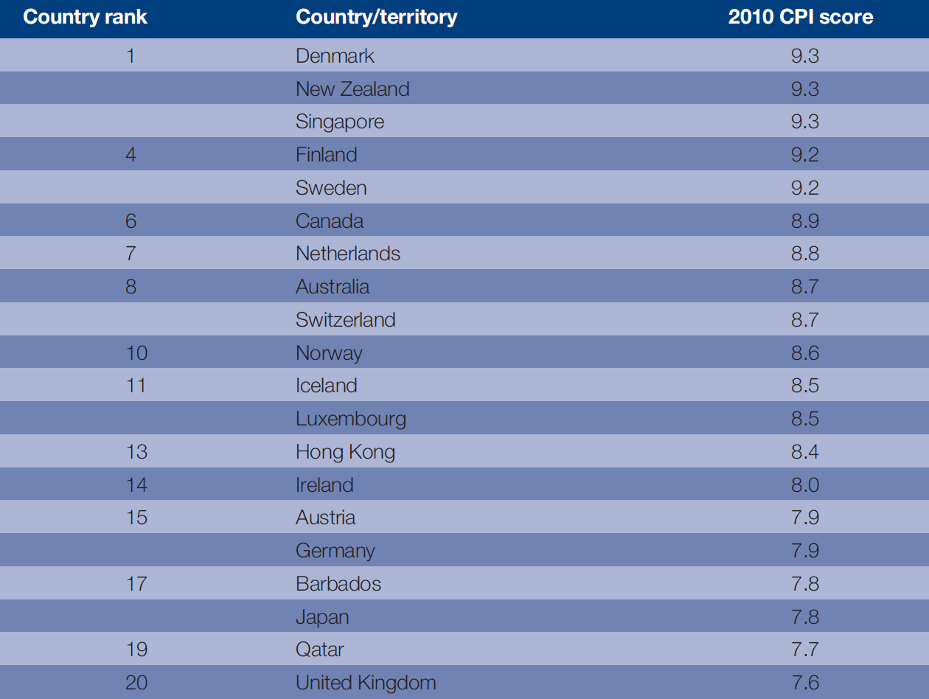
Table 10.1
Transparency international corruption perceptions index 2010
This index measures the perceived levels of public sector corruption in 178 countries around the world.
It scores countries on this scale:
10 = very clean
0 = highly corrupt

Slide 15
Safety, security, & counterterrorism

Slide 16
5 MNE corporate risk areas
In-facility emergency & disaster preparedness
In-facility security
Industrial espionage
Cyber-terrorism
Out-of-facility fire & travel risks

