Slide 1
INTRODUCTION
Chapter 1

Slide 2
INTRODUCTION
Chapter 1
Vocabulary
Objectives
Scope of book
Defining IHRM
Domestic vs. international
Variables that moderate the differences
The cultural environment
Industry type
Extent of MNE reliance on HC market
Senior mgmt. attitudes to international ops.
Applying a strategic view of IHRM
The changing context

Slide 3
Vocabulary
HRM, IHRM
PCN, HCN, TCN
MNE
expatriate = international assignee, inpatriate
repatriation
equity issues
psychological contract
culture shock
convergence/divergence hypotheses
Porter’s value chain model
index of transnationality
global mindset
asymmetric events
environmental dynamics
organizational culture

Slide 4
Objectives
Define IHRM and key terms
Introduce & review expatriate assignment mgmt.
Outline differences between domestic & IHRM
Detail a model that captures these differences
Discover complexity & increasing challenges to existing IHRM practices and models

Slide 5
Scope of book

Slide 6
Figure 1.1
Inter-relationships between approaches to the field

Slide 7
Defining international HRM

Slide 8
HRM activities
Human resource planning
Staffing: recruitment, selection, placement
Performance management
Training & development
Compensation & benefits
Industrial relations

Slide 9
Morgan’s “3-D” definition of IHRM
The HR activities of procurement, allocation & utilization
The countries where IHRM occurs:
Host-country where subsidiary may be located
Parent-country where firm is headquartered
Other-countries that may be source of labor, finance & other inputs
The employees of an international firm:
HCNs (host country nationals)
PCNs (parent .. .. )
TCNs (host .. .. )

Slide 10
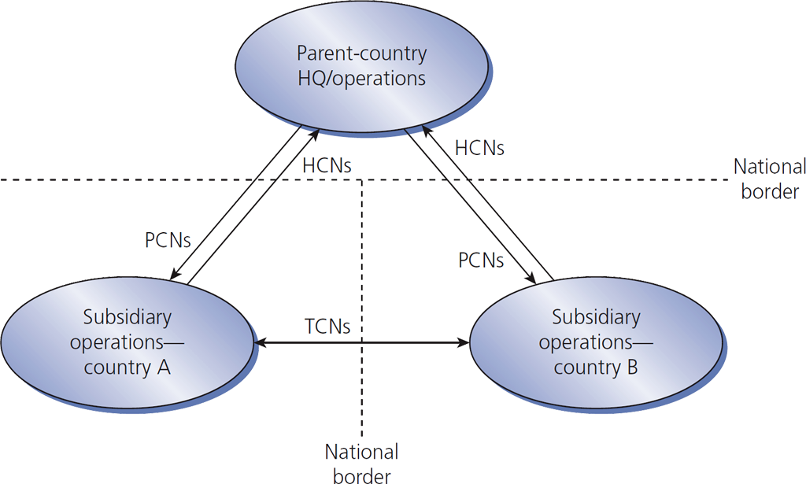
Figure 1.2
International assignments create expatriates

Slide 11
Stahl-Björkman-Morris def. of IHRM
The field of IHRM covers
All issues related to firm outcomes
A wide range of HR issues facing MNEs in different parts of their organizations
This definition includes comparative analyses of HRM in different countries.

Slide 12
Domestic vs. international

Slide 13
IHRM is more complex than domestic HRM
IHRM has …
more HR activities
a need for a broader perspective
more involvement in employees’ personal lives
changes of emphasis as the mix of expatriates & locals varies
more risk exposure
broader external influences

Slide 14
IHRM has international HR activities
International taxation
International relocation & orientation
Administrative services for expatriates
Host-government relations
Language translation services

Slide 15
International relocation involves:
Arranging for pre-departure training
Providing immigration & travel details
Providing housing, shopping, medical care, recreation & schooling information
Finalizing compensation details such as:
Delivery of salary overseas
Determination of overseas allowances
Taxation treatment

Slide 16
Variables that moderate the differences

Slide 17
Four more moderators in addition to IHRM complexity
The cultural environment
The industry(ies) with which the MNE is primarily involved
The extent to which the MNE relies on its HC domestic market
The attitudes of senior management

Slide 18
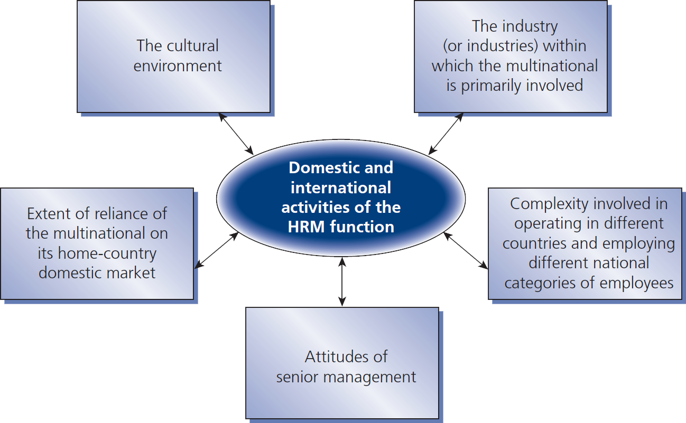
Figure 1.3
A model of all 5 variables that moderate the differences between domestic and international HRM

Slide 19
The cultural environment

Slide 20
Culture matters
Culture shock
Emic ≠ etic
Convergence hypothesis research tends to focus on macro level
Divergence hypothesis research tends to focus on micro level
The international HR manager must be aware of cultural differences

Slide 21
Industry type

Slide 22
The MNE industry type continuum
An MNE performs somewhere in this range:
Multidomestic Industries |  | Global Industries
Examples retailing, distribution, insurance International strategy Collapses to a series of domestic strategies. |  | airlines, semiconductors, copiers Must integrate activities on a worldwide basis.

Slide 23
Laurent’s steps for true IHRM:
Parent org. recognizes that its HRM reflects some assumptions & values of own home culture.
Parent org. recognizes that its own peculiar ways are neither universally better nor worse than others – just different & likely to exhibit strengths & weaknesses, particularly abroad.
Parent org. recognizes that its foreign subsidiaries may prefer other ways to manage people – ways that are neither intrinsically better nor worse, but possibly more effective locally.
Headquarters is willing to acknowledge cultural differences & take steps to make them discussable & therefore usable.
All parties build belief that cross-cultural learning invites more creative & effective ways of managing people.

Slide 24
Extent of MNE reliance on HC market

Slide 25
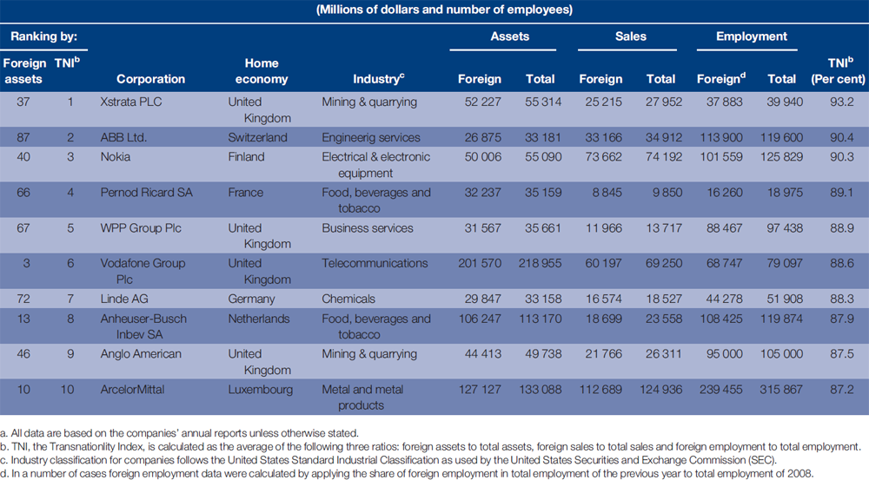
Table 1.1
The world’s top 10 non-financial TNC, ranked by TNI, 2008ª
Chapter 2

Slide 26
Senior management attitudes

Slide 27
What does senior mgmt. think?
Some of the changes required to truly internationalize HR
have more to do with a global mindset than with behaviors.

Slide 28
Applying a strategic view of IHRM

Slide 29
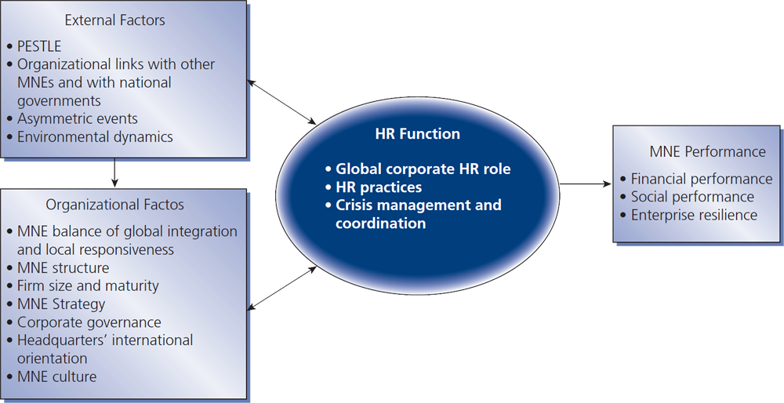
Figure 1.4
A framework of strategic HRM in MNEs

Slide 30
Asymmetric events tend to be
Unmatched in our capabilities & plans
Highly leveraged against our particular assets
Designed to
Secure leverage against our assets
what in other contexts are our strengths
Be difficult to respond to in a discriminate & proportionate manner
Work around,
Offset, & negate

Slide 31
The changing context of IHRM

Slide 32
An MNE case study result
MNEs fail primarily because of
a lack of understanding of
the differences
in managing human resources in foreign environments.

