Slide 1
THE CULTURAL CONTEXT OF IHRM
Chapter 2

Slide 2
THE CULTURAL CONTEXT OF IHRM
Chapter 2
Vocabulary
Objectives
Definitions of culture
Intro to cross-cultural management research
The Hofstede study
The GLOBE study
The Trompenaars & Hampden-Turner study
Hall & Hall’s cultural dimensions
The development of cultures

Slide 3
Vocabulary
Culture as defined by: Kluckhohn & Kroeber, Hansen, Schein
artefacts, values, underlying assumptions
cross-cultural management
Hofstede: power distance, uncertainty avoidance, femininity vs. masculinity, individualism vs. collectivism, long-term orientation Confucianism, Confucianism dynamics
GLOBE: ingroup, in-group collectivism vs. institutional collectivism organizational culture, national culture, gender egalitarianism, assertiveness, performance orientation, humane orientation
Trompenaars, & Hampden-Turner: universalism vs. particularism, communitarianism, neutral vs. emotional, diffuse vs. specific, ascriptive vs. achievement, sequential vs. synchronic time, internal vs. external control
Hall & Hall: high vs. low context, spatial orientation, polychrome vs. monochrome time

Slide 4
Objectives
Learn these key findings and themes:
Definitions of culture
Cultural concepts
Results of various intercultural mgmt. studies: Hofstede, GLOBE, Trompenaars, & others
Reflections on cross-cultural mgmt. research
Development of cultures

Slide 5
Definitions of culture

Slide 6
Kluckhohn & Kroeber def. of culture
Culture consists in patterned ways of
Thinking
Feeling
Reacting
acquired & transmitted mainly by symbols, constituting the distinctive achievements of human groups, including their embodiments in artefacts;
The
essential
core of
culture
traditional ideas &
their attached values
consists of

Slide 7
Hansen’s 4 elements of culture:
Standardization of
Communication
Thought
Feeling
Behavior

Slide 8
Schein’s concept of culture
A culture has 3 levels:
Artefacts - visible
Values – intermediate level of consciousness
Underlying assumptions – invisible, unconscious

Slide 9
Schein’s 6 underlying assumptions
Nature of reality & truth
Time dimension
Effect of spatial proximity & distance
Nature of being human
Type of human activity
Nature of human relationships

Slide 10
Intro to cross-cultural mgmt. research

Slide 11
Goals of cross-cultural mgmt. studies
organizational behavior between countries & cultures
Describe
Compare
Explain & improve interaction between employees, customers, suppliers or business in different countries & cultures

Slide 12
The Hofstede study

Slide 13
Hofstede’s 5 culture dimensions
Power distance
Uncertainty avoidance
Femininity vs. masculinity
Individualism vs. collectivism
Confucianism or long-term orientation

Slide 14
Long-term cultures characterized by:
Great endurance, persistence in pursuing goals
Position of ranking based on status
Adaptation of traditions to modern conditions
Respect of social & status obligations within limits
High savings rates & high investment activity
Readiness to subordinate oneself to a purpose
The feeling of shame

Slide 15
Short-term cultures characterized by:
Personal candor & stability
Avoiding loss of face
Respect of social & status obligations without consideration of costs
Low savings rates & low investment activity
Expectations of quick profit
Respect for traditions
Greetings, presents & courtesies based on reciprocity

Slide 16
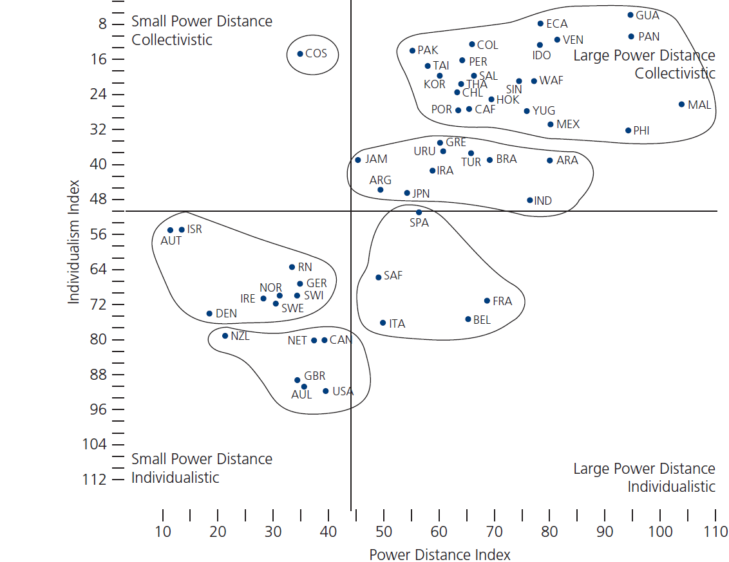
Figure 2.1
Hofstede study: Power distance & individualism vs. collectivism

Slide 17
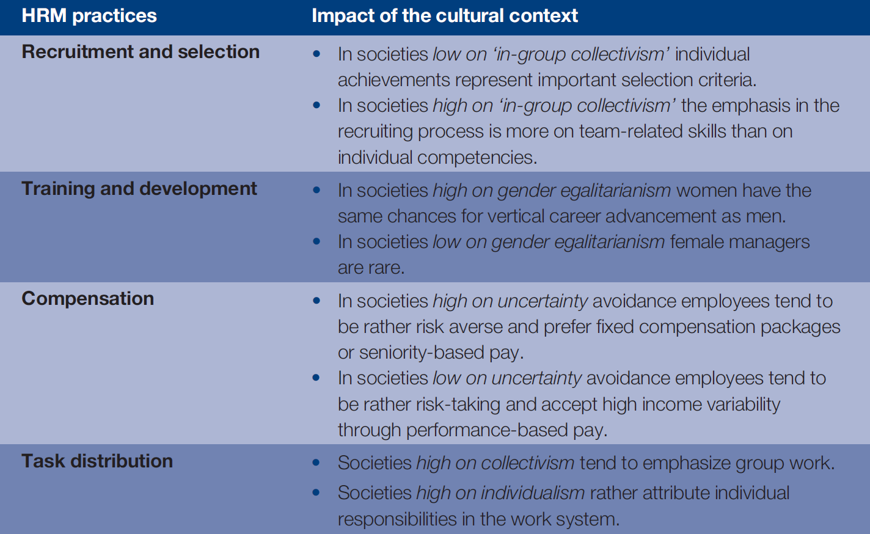
Table 2.1
Impact of the cultural context on HRM practices
Chapter 2

Slide 18
Future Hofstede-style research issues
Realization of cross-level studies Consider groups, organizations, & country levels
Inclusion of cross-cultural differences Consider intracultural variance
Inclusion of theoretically relevant moderators Consider sex, class affiliation, etc.
Interaction between variables

Slide 19
The GLOBE study

Slide 20
The GLOBE study questions
Are there leadership behaviors, attributes & org. practices effective across all cultures?
Are there leadership behaviors, attributes & org. practices effective in some cultures only?
How much do leadership attributes affect the effectiveness of specific leadership behavior & its acceptance by subordinates?
How much do behaviors & attributes in specific cultures influence the well-being of members in the researched societies?
What is the relationship between these socio-cultural variables & an international competitive capacity of the various sample societies?

Slide 21
GLOBE’s 8 culture dimensions
Institutional collectivism
In-group collectivism
Uncertainty avoidance
Power distance
Gender egalitarianism
Assertiveness
Performance orientation
Humane orientation

Slide 22
The Trompenaars & Hampden-Turner study

Slide 23
7 dimensions of Trompenaars & H-T study
a
Relationships between people | Universalism vs. particularism Individualism vs. communitarianism Emotional vs. neutral Specific vs. diffuse Ascription vs. achievement
Concept of time | Sequential vs. synchronic concept of time
Concept of nature | Internal vs. external control
Chapter 2

Slide 24
Hall & Hall’s cultural dimensions

Slide 25
Hall & Hall’s 4 dimensions
High vs. low context communication
Spatial orientation actual distance between people when communicating
Monochrome vs. polychrome time sequential processes vs. parallel actions
Information speed high or low information flow during communication

Slide 26
The development of cultures

Slide 27
Cultures change
There is increasing
International connectedness
Global economy coordination
Harmonization of laws & regulations
Migration
Cultures are not confined to given territories.
This means new challenges for HRM.
How resistant are cultures to change?
Generation Y are fast, self-organized & absorbed learners with distinct work-life balance preferences
Entire society workforces are aging

