Slide 1
THE ORGANIZATIONAL CONTEXT
Chapter 3

Slide 2
THE ORGANIZATIONAL CONTEXT
Chapter 3
Vocabulary
Objectives
Introduction
Standardization & localization of HRM practices
Factors driving standardization
Factors driving localization
The path to global status
Control mechanisms

Slide 3
Vocabulary (1 of 2)
local staff
corporate culture
agents of socialization
international boundary spanners
intrinsic & extrinsic rewards
institutionalism perspective
centralized set-up
country-of-origin, host country, & home country effects
reverse diffusion
local responsiveness
global standardization, localization
SOEs, WOSs
Six Sigma Quality Control
IJV
global innovators
local innovators

Slide 4
Vocabulary (2 of 2)
integrative player
global innovator
implementer
export oriented approach vs. integrative management orientation
corporate immune system
knowledge-sharing hostility, knowledge hoarding
person & non-person oriented coordination
born globals
MNE structures: mother-daughter, matrix, heterarchy, N-form, transnational, network, meta-national
chaebols
greenfield building approach
Bamboo network firm
clan = social control
social capital

Slide 5
Objectives
We learn about:
Issues of standardization & localization
Structural responses to international growth
Control & coordination mechanisms, including cultural control
The effect of responses on HRM approaches & activities

Slide 6
Introduction

Slide 7
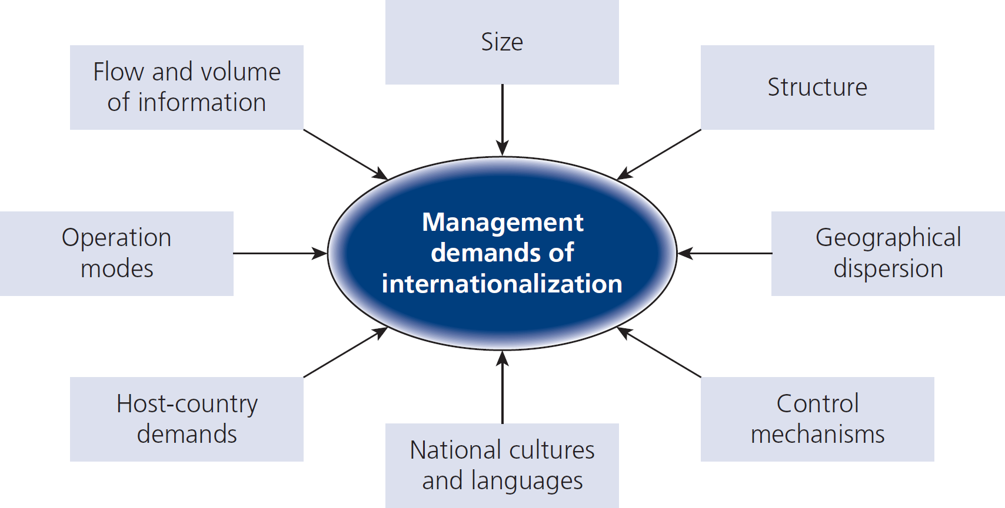
Figure 3.1
Management demands of international growth

Slide 8
Standardization & localization of HRM practices

Slide 9
Why globally standardize HRM?
Consistency
Transparency
Alignment
of a geographically fragmented workforce
around common
Principles
Objectives

Slide 10
Why locally responsive HRM?
To respect local
Cultural values
Traditions
Legislation
Government policies
Education systems
regarding HRM and work practices

Slide 11
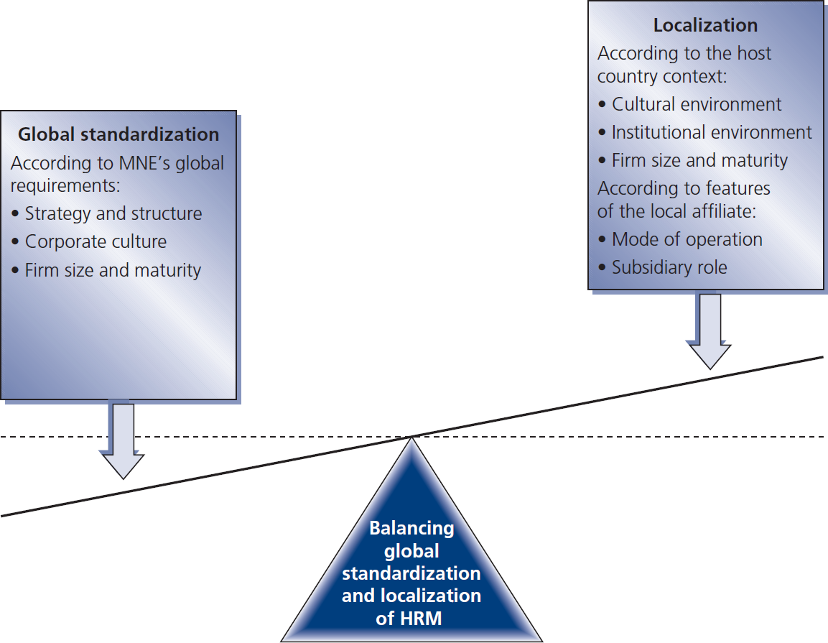
Figure 3.2
Balancing the standardization and localization of HRM in MNEs

Slide 12
Factors driving standardization

Slide 13
MNEs that standardize
pursue multinational or transnational corporate strategies
supported by corresponding org structures that are
reinforced by a shared worldwide corporate culture

Slide 14
Factors driving localization

Slide 15
Localization factors include:
Cultural environment more social context → more complete balance of extrinsic & intrinsic rewards more individual → more extrinsic rewards or fast changing personal & social contexts
Institutional environment (country-of-origin & HC)
Mode of operation abroad
Subsidiary role: e.g., global innovator, integrated player, implementer

Slide 16
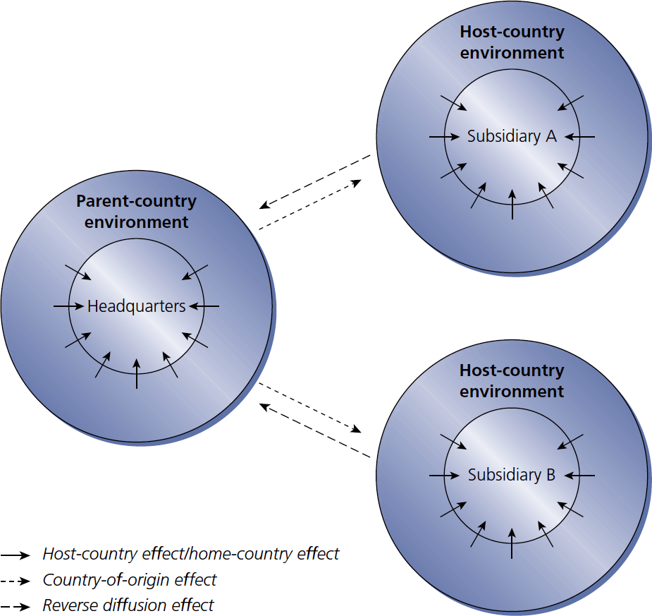
Figure 3.3
Institutional effects on MNEs

Slide 17
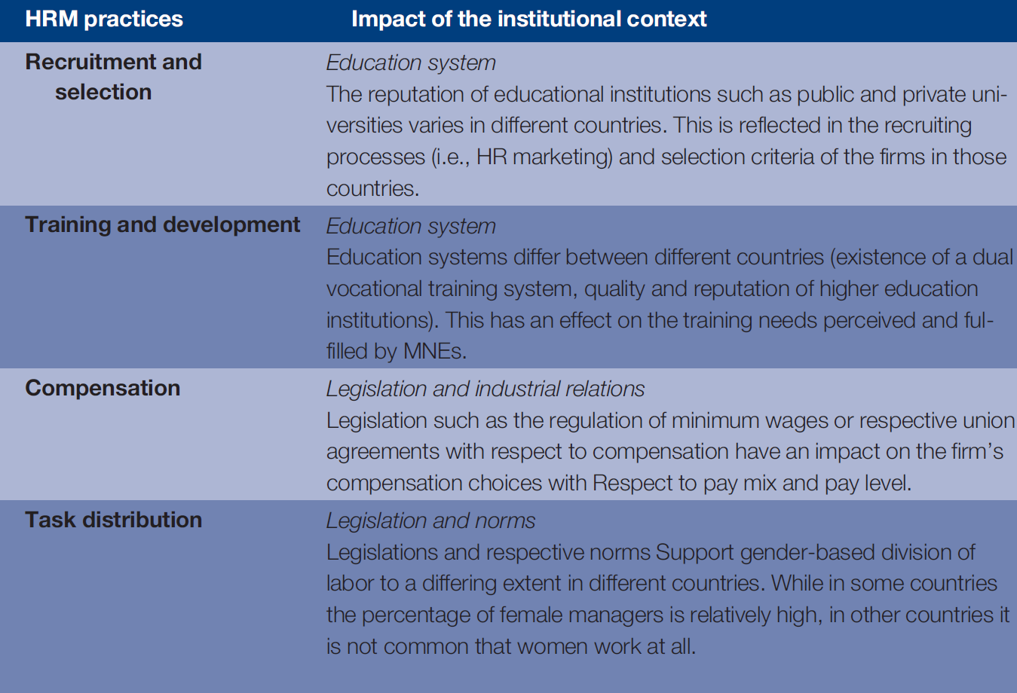
Table 3.1
Examples of impact of the cultural & institutional context on HRM practices
Chapter 3

Slide 18
Table 3.2
Gupta & Govindarajan’s four generic subsidiary roles

Slide 19
The path to global status

Slide 20
Organizational structures typically change due to
Strain imposed by growth & geographical spread
Need for improved coordination & control across business units
Constraints imposed by host-government regulations on ownership and equity

Slide 21
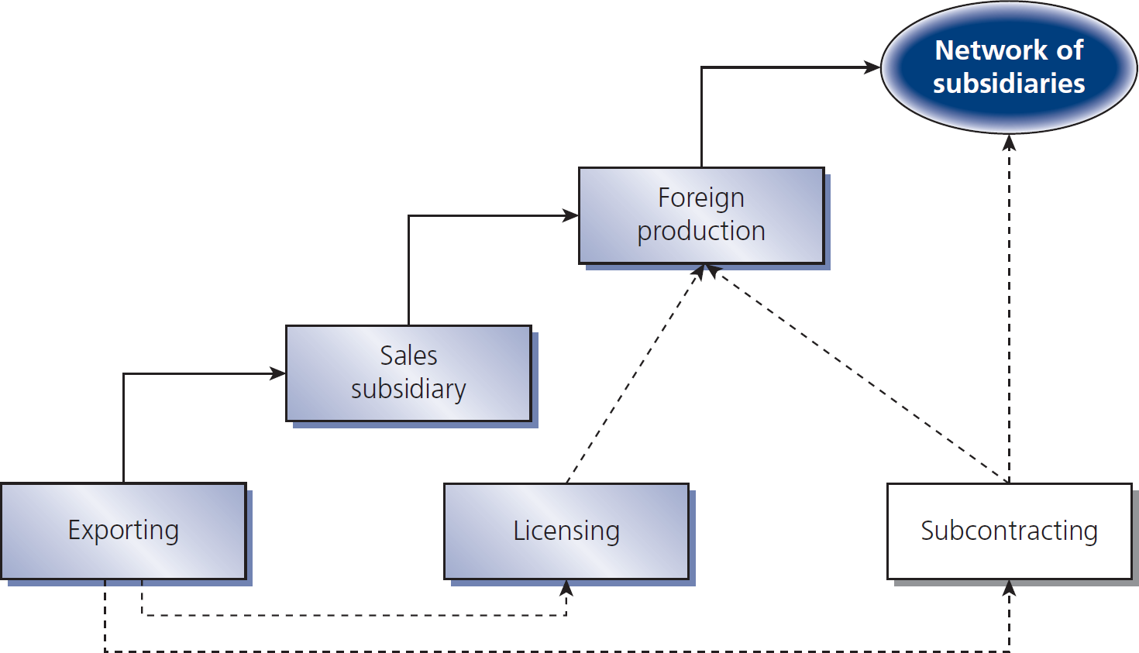
Figure 3.4
Stages of internationalization

Slide 22
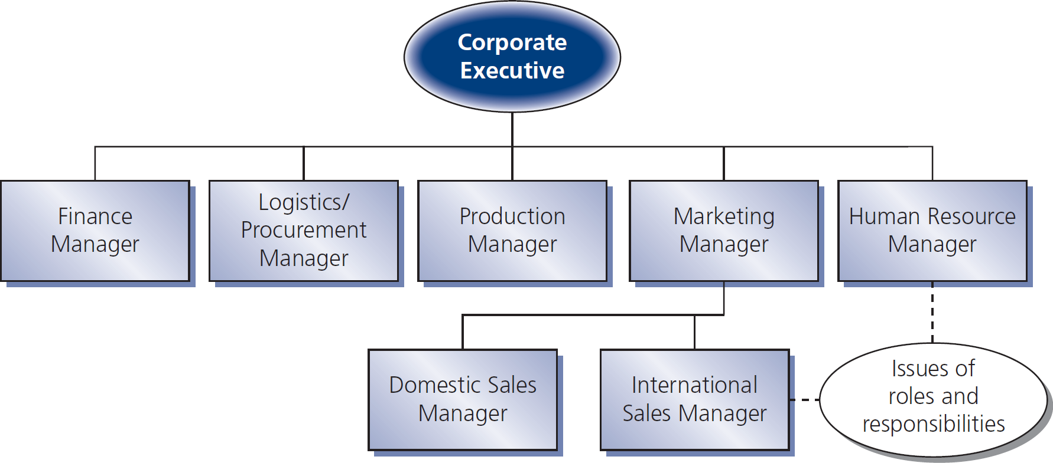
Figure 3.5
Export department structure

Slide 23
Figure 3.6
Sales subsidiary structure

Slide 24
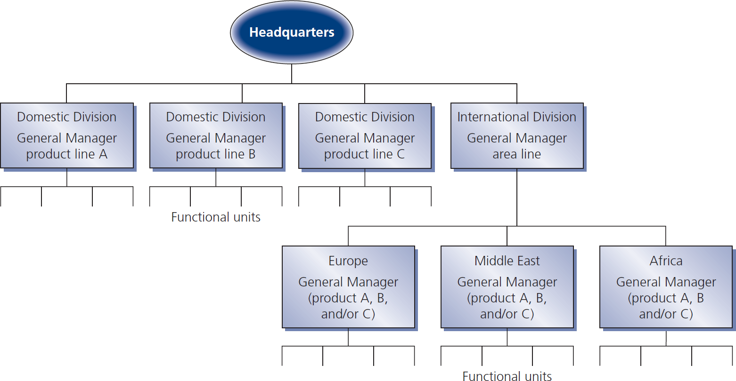
Figure 3.7
International division structure

Slide 25
Two major MNE issues of structure
Extent to which key decisions are made at PC headquarters or at subsidiary units (centralization vs. decentralization)
Type of control exerted by the parent over the subsidiary unit

Slide 26
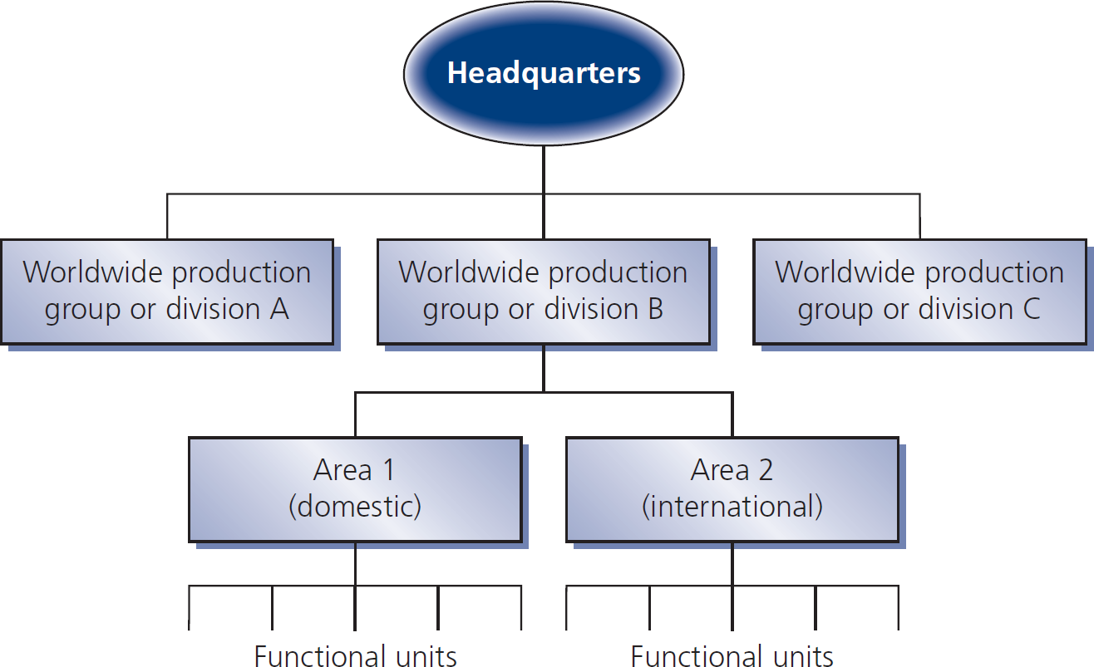
Figure 3.8A
Global product division structure

Slide 27
Figure 3.8B
Global product division structure

Slide 28
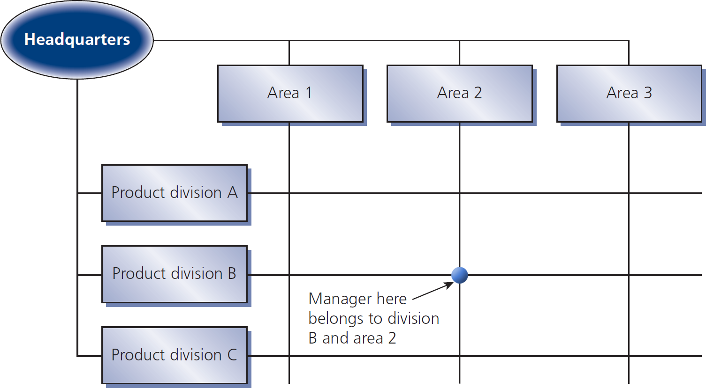
Figure 3.9
Global matrix structure
Chapter 3

Slide 29
Internationally, matrix is difficult
Dual reporting can cause conflict & confusion
Many communication channels can create information logjams
Overlapping responsibilities can produce - turf battles - loss of accountability
Distance, language, time, & culture barriers make it difficult for managers to resolve conflicts & clarify confusion

Slide 30
Matrix requires managers who
Know the business in general
Have good interpersonal skills
Can deal with ambiguities of responsibility & authority
Have training for presenting ideas in groups
HR planning in matrix MNEs is more critical than in traditional organizations

Slide 31
Beyond the matrix org. structures
The Heterarchy MNEs have different kinds of centers apart from ‘headquarters’
The Transnational resources & responsibilities are interdependent across national boundaries
The Network subsidiaries are nodes, loosely coupled political systems
At this stage, there is less hierarchy & no structure is considered inherently superior

Slide 32
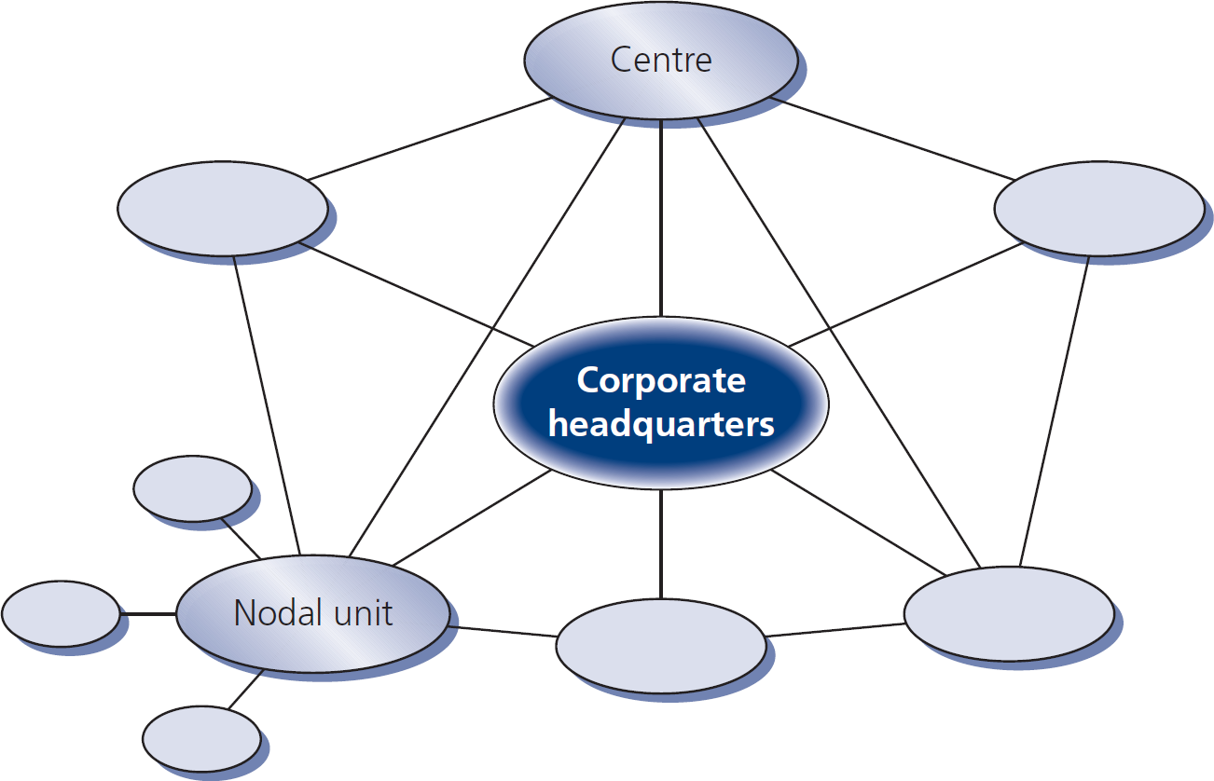
Figure 3.10
The networked organization

Slide 33
5 dimensions of networked MNEs
Decision-making authority is delegated to appropriate units & levels
Key functions are dispersed geographically across units in different countries
Fewer organizational levels
Formal procedures are less bureaucratic
Work, responsibility, & authority are differentiated across the networked subsidiaries

Slide 34
Beyond networks: meta-nationals
Meta-nationals have 3 types of units:
Sensing units Uncover widely dispersed engineering & market insights
Magnet units Attract & create business plan to convert innovations into products & services
Marketing & production units Market & produce adaptations of these products & services around the world
Think: An M-N = global tournament played at 3 levels

Slide 35
HR’s place in structural forms
Three ways HR develops with international growth:
Centralized HR firms large, well-resourced: typically product-based or matrix structures
Decentralized HR firms small group, mostly for senior mgmt. at corp. HQ: mostly product- or regional-based structures
Transition HR firms medium-sized corp. HR with small staff at HQ: decentralized, product-based structure

Slide 36
Different countries, different paths
European MNEs: ‘mother-daughter’ → global with product/area divisions or matrix structure
Swedish MNEs: Tend to adopt mixture of mother-daughter & product divisions
Nordic MNEs: may prefer matrix structure
United States MNEs: limited success with matrix
Japanese MNEs: similar to US, but evolve more slowly, possibly not changing structure
Not much info yet on Chinese & Indian MNEs

Slide 37
Control mechanisms

Slide 38
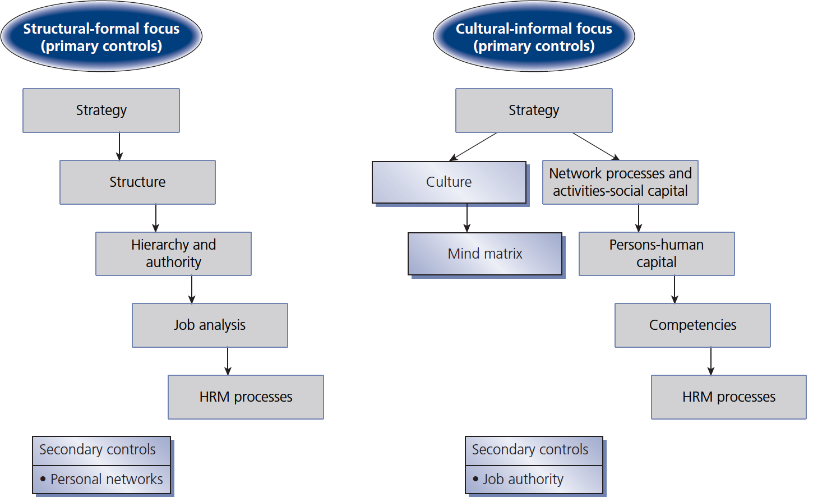
Figure 3.11
Control strategies for multinational firms

