Slide 1
Sourcing HR for Global Markets: STAFFING, RECRUITMENT & SELECTION
Chapter 5

Slide 2
Sourcing HR for Global Markets: STAFFING, RECRUITMENT & SELECTION
Chapter 5
Vocabulary
Objectives
Introduction
Approaches to staffing
Transferring staff for international activities
Roles of an expatriate
Role of non-expatriates
Role of inpatriates
Recruitment & selection of international managers
Expatriate failure & success
Selection criteria
Expatriate selection processes in practice
Dual career couples

Slide 3
Vocabulary
ethnocentric, polycentric, geocentric, regiocentric
Kinds of assignments: short-term, extended, long-term = traditional expatriate assignment, commuter, rotational, contractual, virtual, self-initiated
Expatriate roles: language node, agent of direct control, agent of socializing, network builder, transferer of competence & knowledge, boundary spanner
best practice
tacitness
inpatriates, external recruits
internal recruitment, headhunting
expatriate failure, EFRs, direct & indirect costs
selection criteria, soft skills, intercultural competence, cultural intelligence, common corporate language
honeymoon = tourist phase
coffee-machine system
ethnorelativism

Slide 4
Objectives
We learn foundations of ‘managing people’ in IHRM:
Issues related to approaches to staffing foreign ops.
Reasons for international assignments
Types of international assignments
Expatriate & non-expatriate roles in supporting international business activities
Then we learn about IHRM recruitment & selection:
Debate about expatriate failure, selection criteria, & gender in IHRM

Slide 5
Introduction

Slide 6
This chapter
Examines various approaches to international staffing
Outlines pivotal role of international assignments
Focuses on recruitment & selection as major factors in success of global assignments

Slide 7
Approaches to staffing

Slide 8
Staffing attitudes of internationalizing firms
Ethnocentric – PCNs are favored
Polycentric – HCNs manage subsidiaries
Geocentric – Ability is more important than nationality
Regiocentric – Similar to geocentric, but limited to a given region

Slide 9
Table 5.1a
Advantages & disadvantages of using PCNs

Slide 10
Table 5.1b
Advantages & disadvantages of using TCNs

Slide 11
Table 5.1c
Advantages & disadvantages of using HCNs

Slide 12
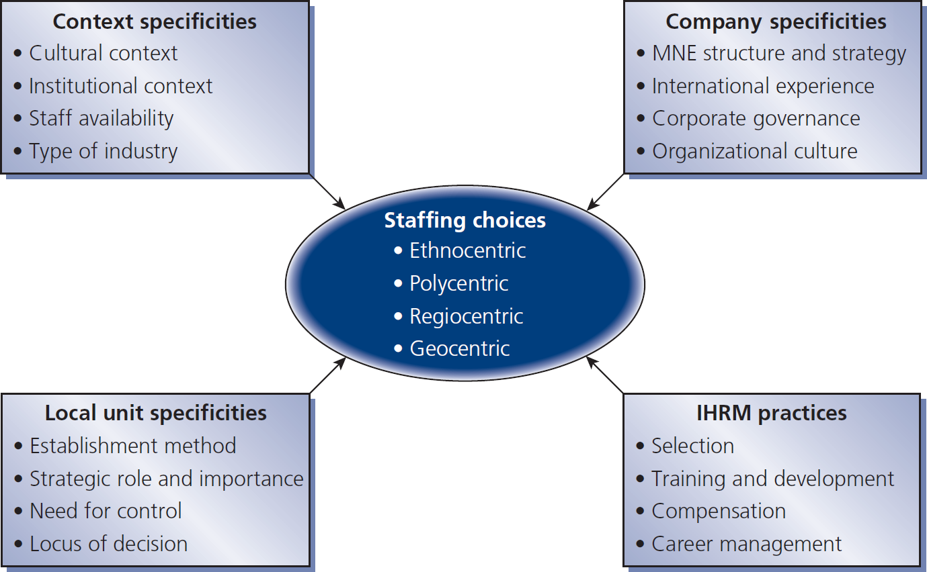
Figure 5.1
Determinants of staffing choices

Slide 13
Transferring staff for international activities

Slide 14
Reasons for international assignments
Position filling lack of available skills → PCN works abroad
Management development - training, development, common corp. values
Organization development - transfer of knowledge, competence, practices - exploit global market opportunities

Slide 15
Types of international assignments
Short term up to 3 months
Extended up to 1year
Long term 1 to 5 years (traditional expatriate assignment)
Some non-standard assignments:
Commuter go home every one to two weeks
Rotational commute for set period followed by break in home country
Contractual specific skills employees hired for 6-12 months on specific projects
Virtual employee manages international responsibilities from base in home country

Slide 16
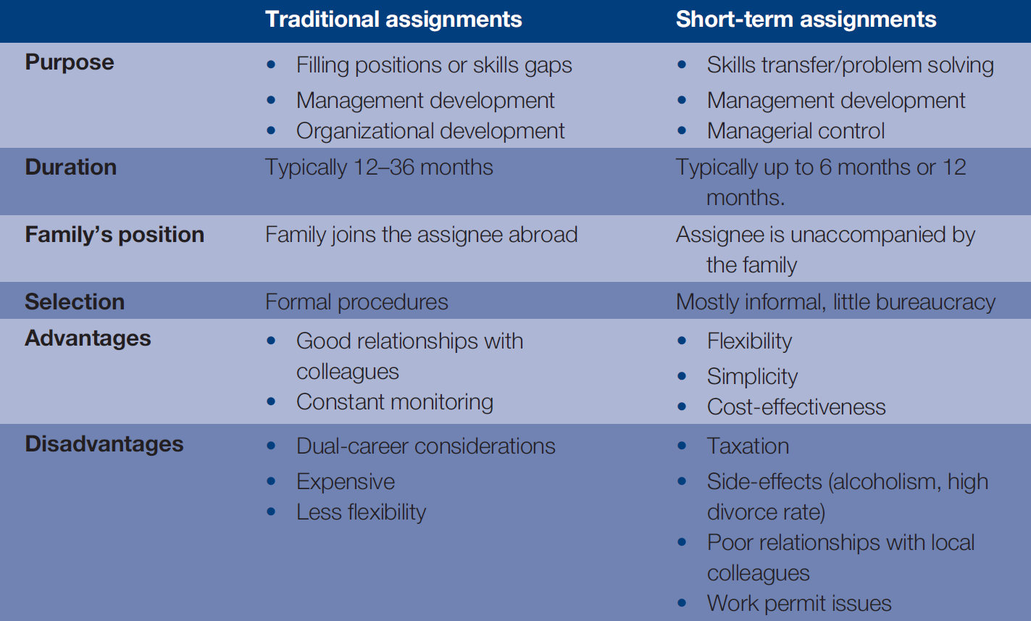
Table 5.2
Differences between traditional & short-term assignments
Chapter 5

Slide 17
Roles of an expatriate

Slide 18
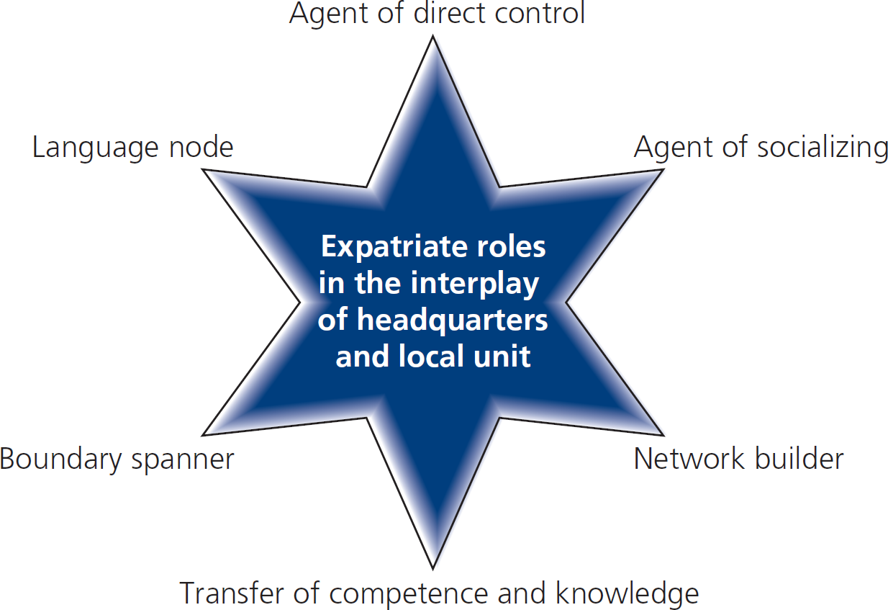
Figure 5.2
Determinants of staffing choices

Slide 19
Factors that influence effectiveness of international assignments
Open environment
Support for cross-fertilization of ideas
Implementation of best practice
Knowledge/info travels freely between expatriate, host country, & parent country
Consideration for personal networks
Some knowledge transfer requires longer assignments (e.g., where there is much tacitness)
Expatriate’s ability & motivation to act as an agent of knowledge transfer
Abilities, motivations, relationships of locals

Slide 20
Role of non-expatriates

Slide 21
Issues with international business travelers
Home & family issues
Work arrangements
Travel logistics
Health concerns
Host culture issues

Slide 22
Role of inpatriates

Slide 23
Drivers for recruiting & transferring inpatriate mgrs.
Desire to create global core competency & cultural diversity of strategic perspectives
Desire to provide career opportunities in HCs
The emergence of developing markets which often are difficult locations for expatriates:
Quality of life adjustment
Cultural adjustment

Slide 24
Recruitment & selection of international managers

Slide 25
International vs. domestic recruitment & selection
Smaller number of external recruits
Preference for internal recruitment
To reduce selection risk
To secure present & past human capital investments

Slide 26
Expatriate failure & success

Slide 27
Table 5.3
Expatriate failure rates

Slide 28
Selection criteria

Slide 29
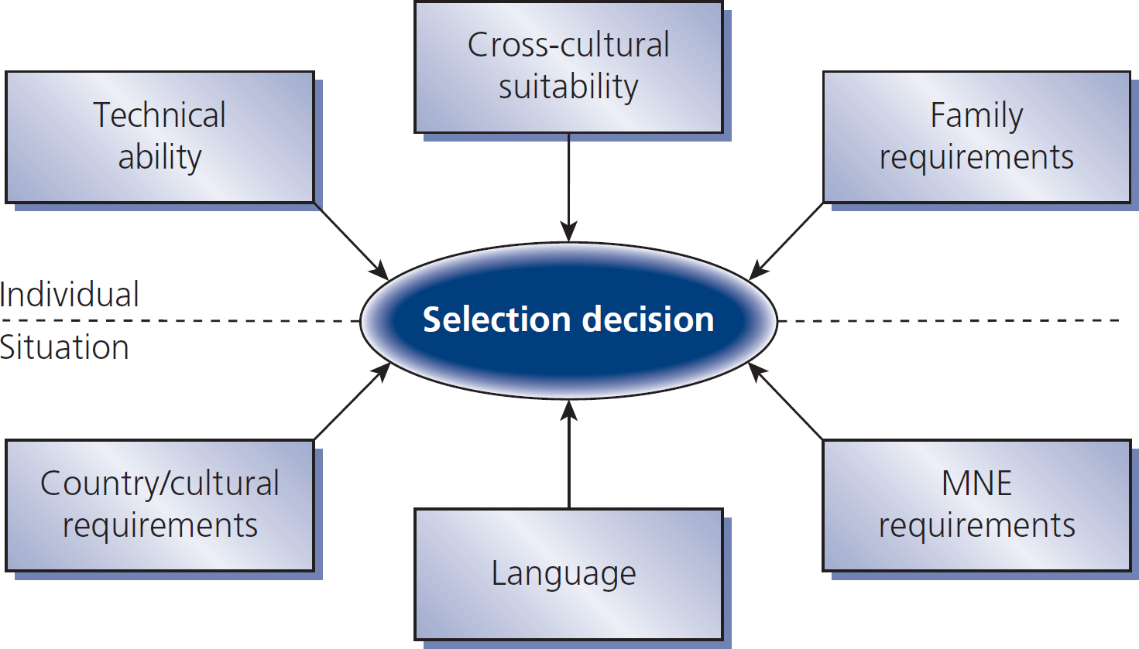
Figure 5.3
Factors in expatriate selection

Slide 30
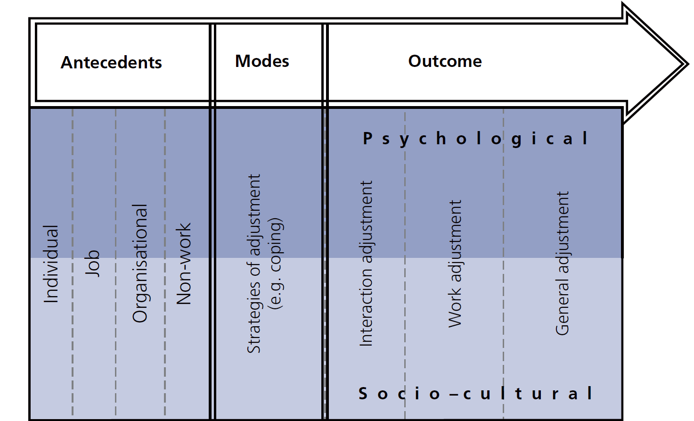
Figure 5.4
Overview of important adjustment variables

Slide 31
Expatriate selection processes in practice

Slide 32
Table 5.4
Tasks & exercises used in an assessment center

Slide 33
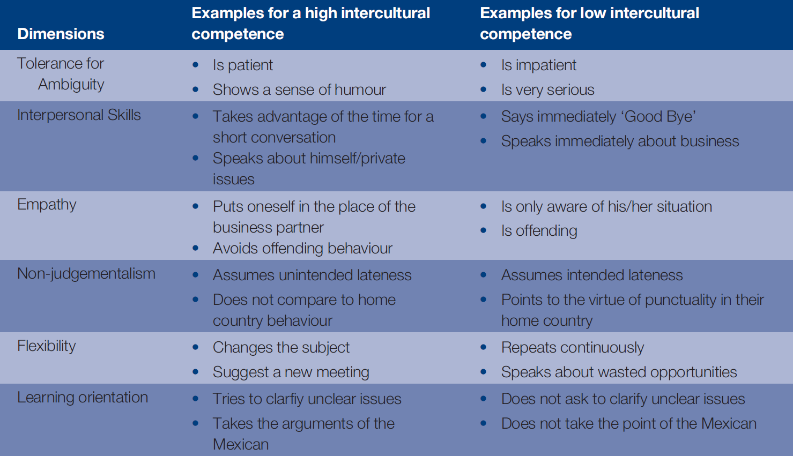
Table 5.5
Evaluation scheme for a role play in an intercultural assessment center
Chapter 5

Slide 34
Dual career couples

Slide 35
IHRM solutions for dual career couples
Inter-firm networking
Job-hunting assistance
Intra-firm employment
Language training, educational assistance
Employer-sponsored work permits
Career planning assistance

Slide 36
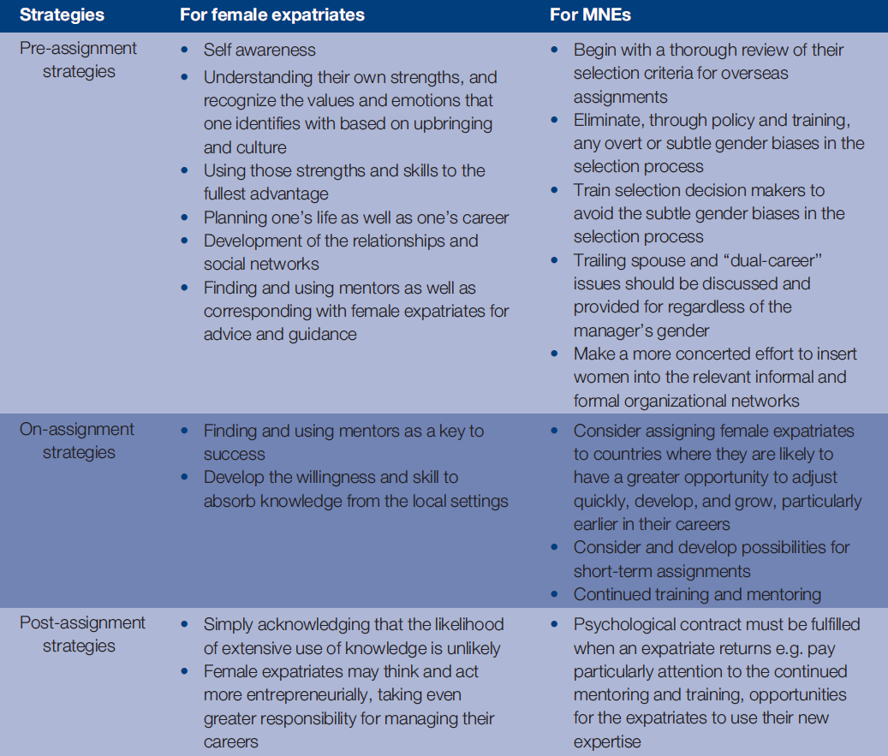
Table 5.6
Strategies for breaking the expatriate glass ceiling

