Slide 1
INTERNATIONAL PERFORMANCE MANAGEMENT
Chapter 6

Slide 2
INTERNATIONAL PERFORMANCE MGMT.
Chapter 6
Vocabulary
Objectives
Introduction
Multinational performance management
Control & performance management
Performance mgmt. of int. employees
Performance appraisal of int. employees

Slide 3
Vocabulary
performance management, performance appraisal
foreign subsidiary
bureaucratic control system, relative comparative data
expatriate = PCNs, TCNs, and HCNs on assignment to headquarters = international employee
compensation package, remuneration
tasks: CEO, structure reproducer, troubleshooter, operative
types of assignments: technical, developmental, strategic, functional
role clarity, role expectations, going native
merit-based, intellectual capital, competency-based
collective bargaining
virtual assignees
hard goals, soft goals, contextual goals
360-degree feedback process
communication medium
cultural applicability

Slide 4
Objectives
We address:
Multinational performance management at the global & local level: ■ non-comparable data ■ volatility of the global environment ■ effect of distance ■ level of subsidiary maturity
Performance management as part of a MNE’s control system
Factors associated with expatriate performance, including ■ compensation package ■ headquarters’ support ■ task & role ■ host environment factors
Performance management of
expatriates & non-expatriates
those on non-standard tasks & assignments such as commuters & virtual workers
Issues related to performance appraisal of international employees

Slide 5
Introduction

Slide 6
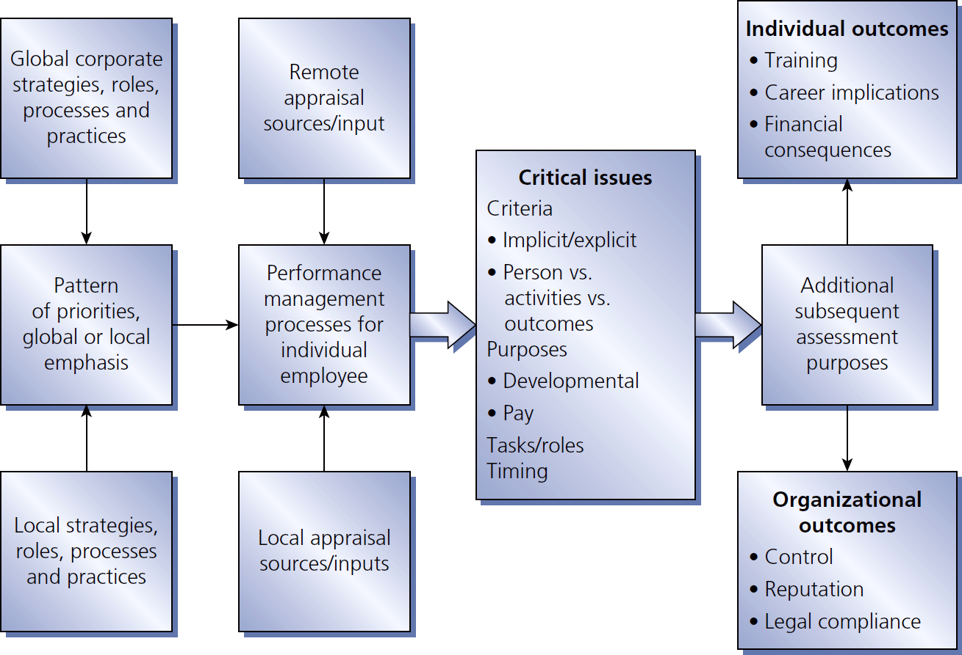
Figure 6.1
Perspectives, issues, actions & consequences in MNE performance management

Slide 7
Multinational performance management

Slide 8
MNE performance mgmt. constraints
Whole vs. part
Non-comparable data
Volatility in the global business environment
Separation by time & distance
Variable levels of maturity across markets: the need for relevant comparative data

Slide 9
Control & performance management

Slide 10
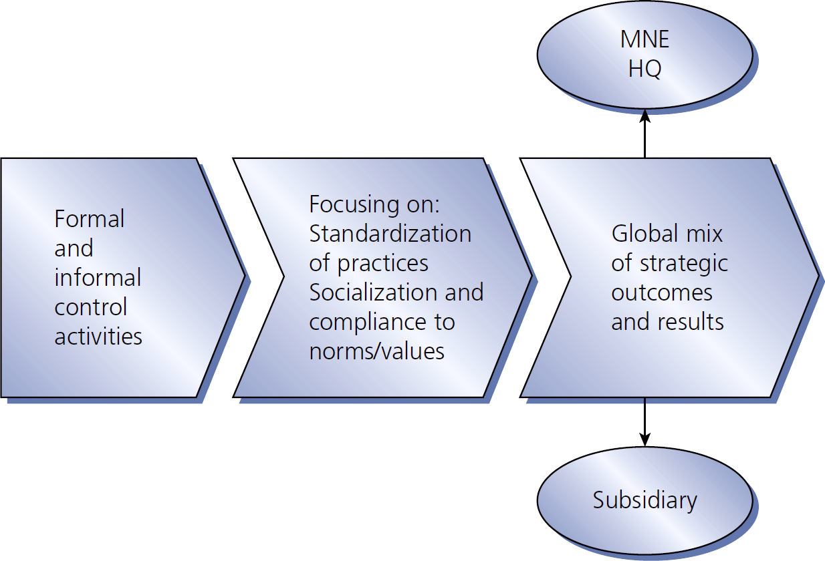
Figure 6.2
MNE control & performance

Slide 11
Performance management of international employees

Slide 12
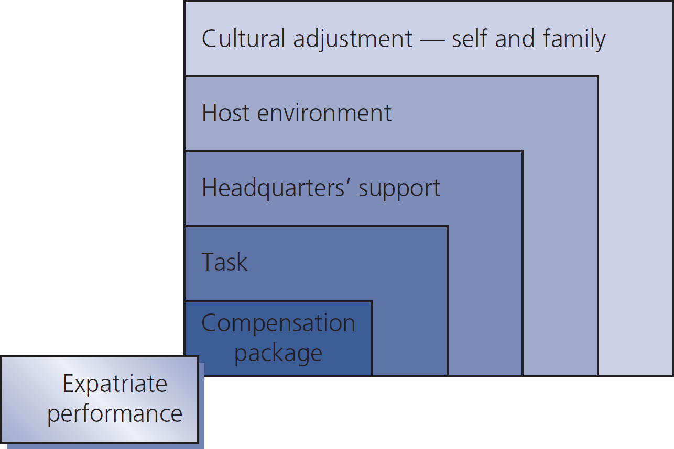
Figure 6-3
Variables affecting expatriate performance

Slide 13
Expatriate tasks
CEO or subsidiary manager oversees & directs entire foreign operation
Structure reproducer reproduces structure similar to what s/he knows from another part of the company
Troubleshooter analyzes & solves a particular operational problem
Operative performs functional job tasks in existing operational structure, in generally lower level, supervisory positions

Slide 14
Types of expatriate assignments
Technical (5-10%) short-term knowledge transfer
Developmental (5-10%) in-country performance & acquisition of local understanding by assignee
Strategic (10-15%) high-profile activities for developing global perspective
Functional (55-80%) more enduring two-way transfer of existing processes & practices

Slide 15
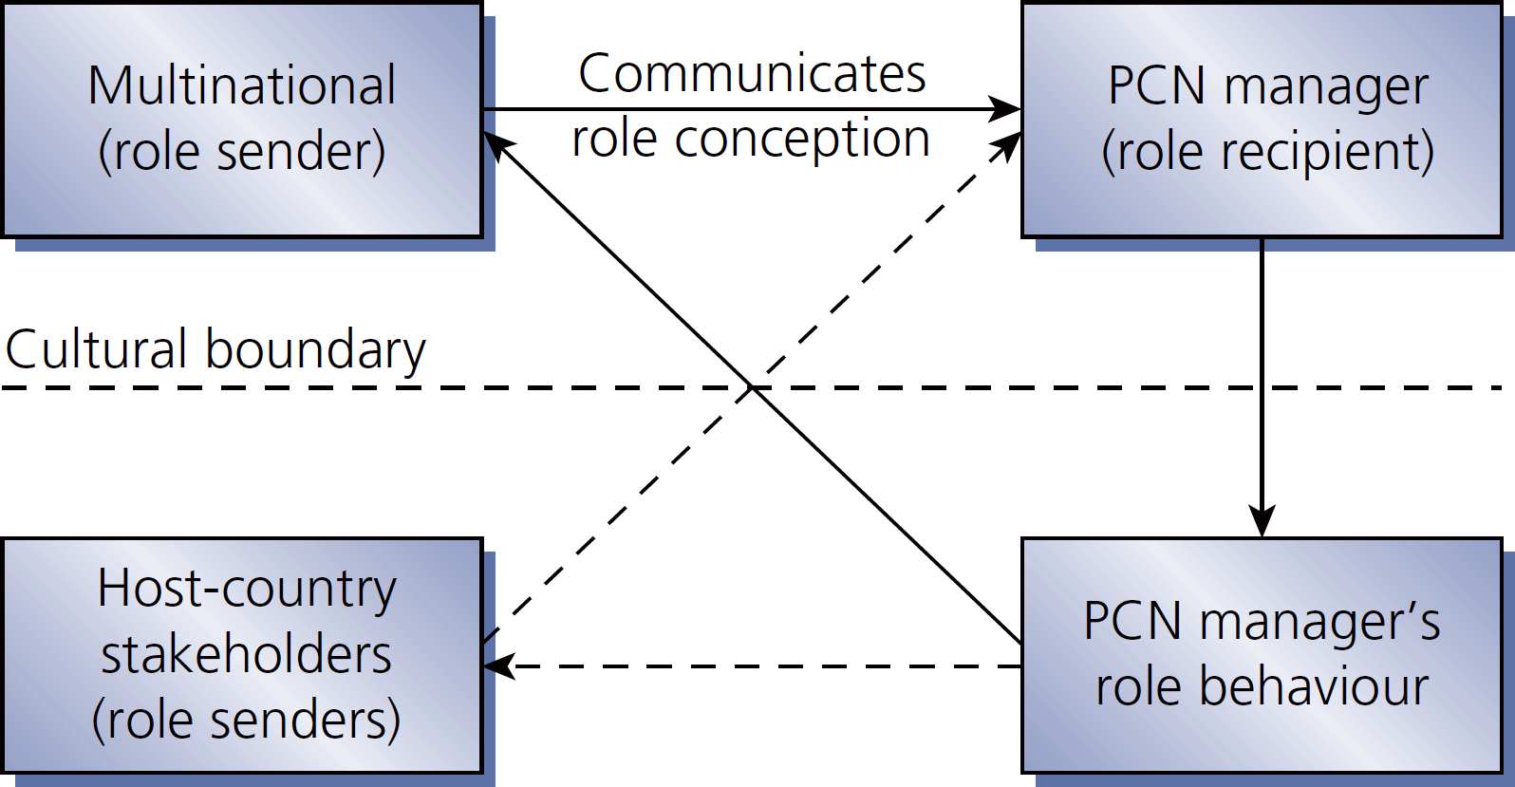
Figure 6.4
PCN role conception

Slide 16
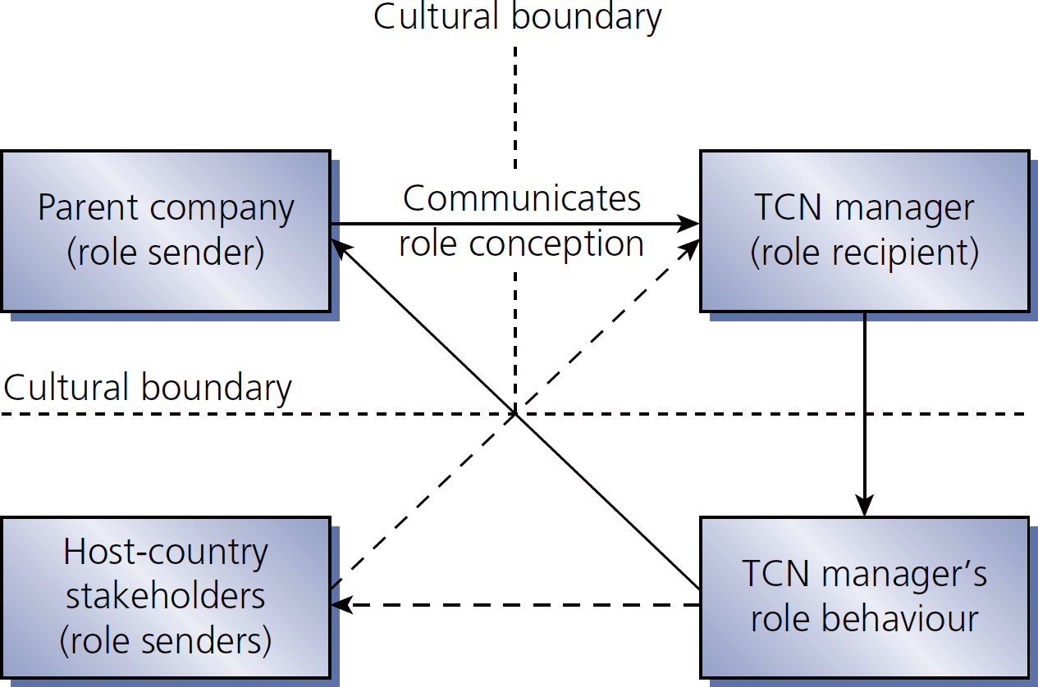
Figure 6.5
TCN role conception

Slide 17
Non-expatriate performance management challenges
Performance criteria & goals for non-standard work
Criteria for performance is subject to cultural differences
Isolating international dimensions of job performance is not as straightforward as for traditional expatriate jobs
Outstanding/under-performance & failures will challenge performance appraisal process
Performance appraisals are complicated by international context, outside appraisers
Ways to improve & rewards are unclear
Impact of non-standard work on HCN co-workers

Slide 18
Performance appraisal of international employees

Slide 19
Performance appraisal aspects of international employees
Performance criteria hard, soft, & contextual goals
Who conducts the performance appraisal? typically subsidiary manager, but could be team of evaluators
Standardized or customized appraisal forms?
Frequency of appraisal?
Performance feedback the communication medium matters
Appraisal of HCN employees

Slide 20
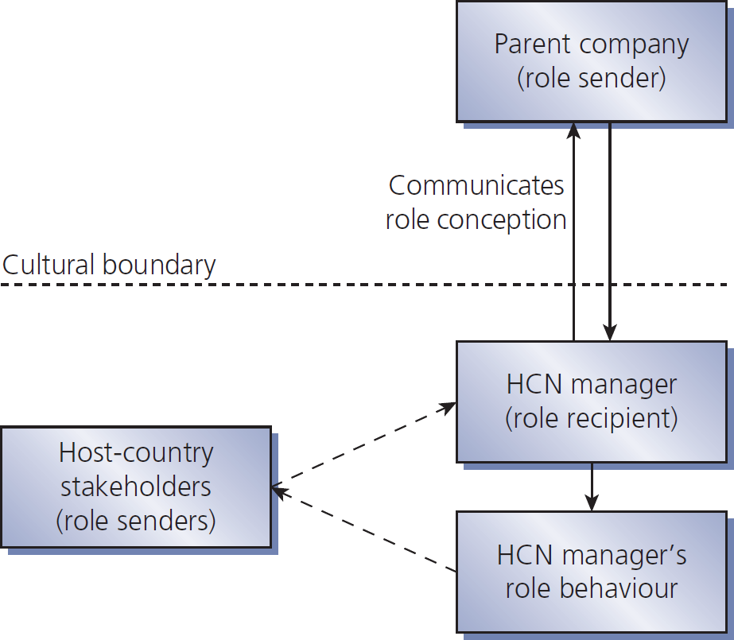
Figure 6.6
HCN role conception

