Slide 1
INTERNATIONAL TRAINING, DEVELOPMENT, & CAREERS
Chapter 7

Slide 2
INTERNATIONAL TRAINING, DEVELOPMENT, & CAREERS
Chapter 7
Vocabulary
Objectives
Introduction
Components of effective pre-departure training
Effectiveness of pre-departure training
Developing staff through international assignments
Trends in international training & development
Re-entry & career issues
Repatriation process
Individual reactions to re-entry
Responses by the MNE
Designing a repatriation program

Slide 3
Vocabulary
T&D = training & development, the human resource, NGOs
internal hires
cultural awareness training, CCT, field experiences, degree of expected interaction, cultural similarity
information-giving, affective, & immersion approaches, security briefings
role-playing
preliminary visit
international cadre
multinational, virtual teams
repatriation, ROI
reverse culture shock
mentors, repatriation program
career anxiety, work adjustment
family adjustment, social networks
boundaryless careers, protean careers
international itinerants
Additional types of training:
Language
Critical incidents
Culture assimilator
Stress reduction
Simulations
Sensitivity

Slide 4
Objectives: before & during
We examine these pre- & on-assignment issues:
Role of training to support expatriate adjustment & on-assignment performance
Components of pre-departure training programs such as cultural awareness, preliminary visits, & language skills
Relocation assistance & training for trainers
Effectiveness of pre-departure training
Developmental aspect of international assignments
Training & developing international mgmt. teams
Trends in international training & development

Slide 5
Objectives: post-assignment
We examine these re-entry issues:
Process of re-entry or repatriation
Job-related issues
Social factors (e.g., family) that affect re-entry & work adjustment
MNE responses to repatriate concerns
Staff availability & career issues
ROI & knowledge transfer
Designing a repatriation program
Broader international career issues

Slide 6
Introduction

Slide 7
International assignment as a training & development tool
Expatriates are trainers - part of knowledge & competence transfer - expected to help train & develop HCNs
Expatriates ensure adoption - show how systems & processes work - monitor HCN performance
Expatriates are mgmt. under development - job rotation → broader perspective - they become global operators

Slide 8
Figure 7.1
International training & development

Slide 9
Table 7.1
Availability of cross-cultural training in MNEs

Slide 10
Components of effective pre-departure training

Slide 11
Essential components of pre-departure training
Cultural awareness training
Preliminary visits
Language instruction
Assistance with practical day-to-day matters
Security briefings

Slide 12
Black & Mendenhall’s 3 keys for cross-cultural training
Training methods
Levels of training rigor
Duration of training relative to
Expected degree of interaction
Culture novelty = how different host culture is from native culture

Slide 13
Information-giving approach
< 1 week training
Low interaction, similar cultures
Emphasize information-giving approach:
Area or cultural briefings
Lectures, movies, books
Interpreters
‘Survival-level’ language training

Slide 14
Affective approach
2-12 month job, some interaction
more training rigor 1-4 + weeks long
Emphasize affective approach:
Role-playing
Critical incidents
Culture assimilator training
Case studies
Stress reduction training
Moderate language training

Slide 15
Immersion approach
High interaction, novel culture
more training rigor 2+ months long
Emphasize immersion approach:
Assessment center
Field experiences
Simulations
Sensitivity training
Intercultural web-based workshop
Extensive language training

Slide 16
Effectiveness of pre-departure training

Slide 17
Table 7.2
Perceived value of cross-cultural preparation of expatriates

Slide 18
Developing staff through international assignments

Slide 19
Outcomes of international assignments
Management development
Individuals get experience, advance careers
MNE gets cadre of experienced international operators
Organizational development
MNE accumulates knowledge, abilities
MNE & individuals get a global mindset
MNE gets direct control & socialization which - helps with knowledge transfer & - helps transfer competence

Slide 20
Networked MNEs can use international teams as
a mechanism for fostering innovation, organizational learning, knowledge transfer
a means of breaking down functional & national boundaries, enhancing information flows
a method for encouraging diverse decision-making, problem-solving, & strategic assessments
an opportunity for developing a global perspective
a technique for developing shared values; thus helping MNE with informal, normative control through socialization

Slide 21
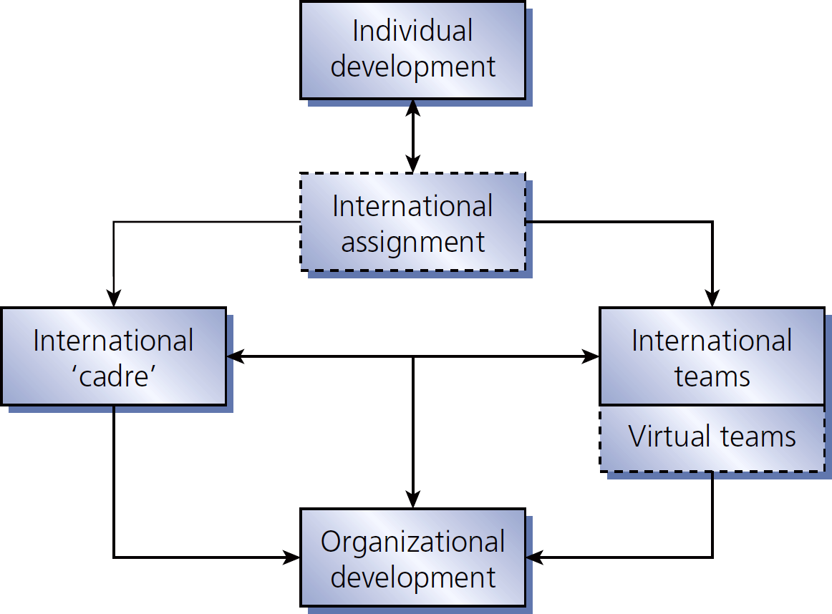
Figure 7.2
Developing international teams through international assignments

Slide 22
Trends in international training & development

Slide 23
Some training & development trends
Host countries continue to pressure for local T&D
Growing realization that competence learning depends on national context & HC institutions
Increasing awareness of NGOs’ importance
Increasing interest in T&D focused on China
T&D literature is realizing need to address
global,
comparative, &
national contexts for T&D (just as IHRM is starting to do)

Slide 24
Re-entry & career issues

Slide 25
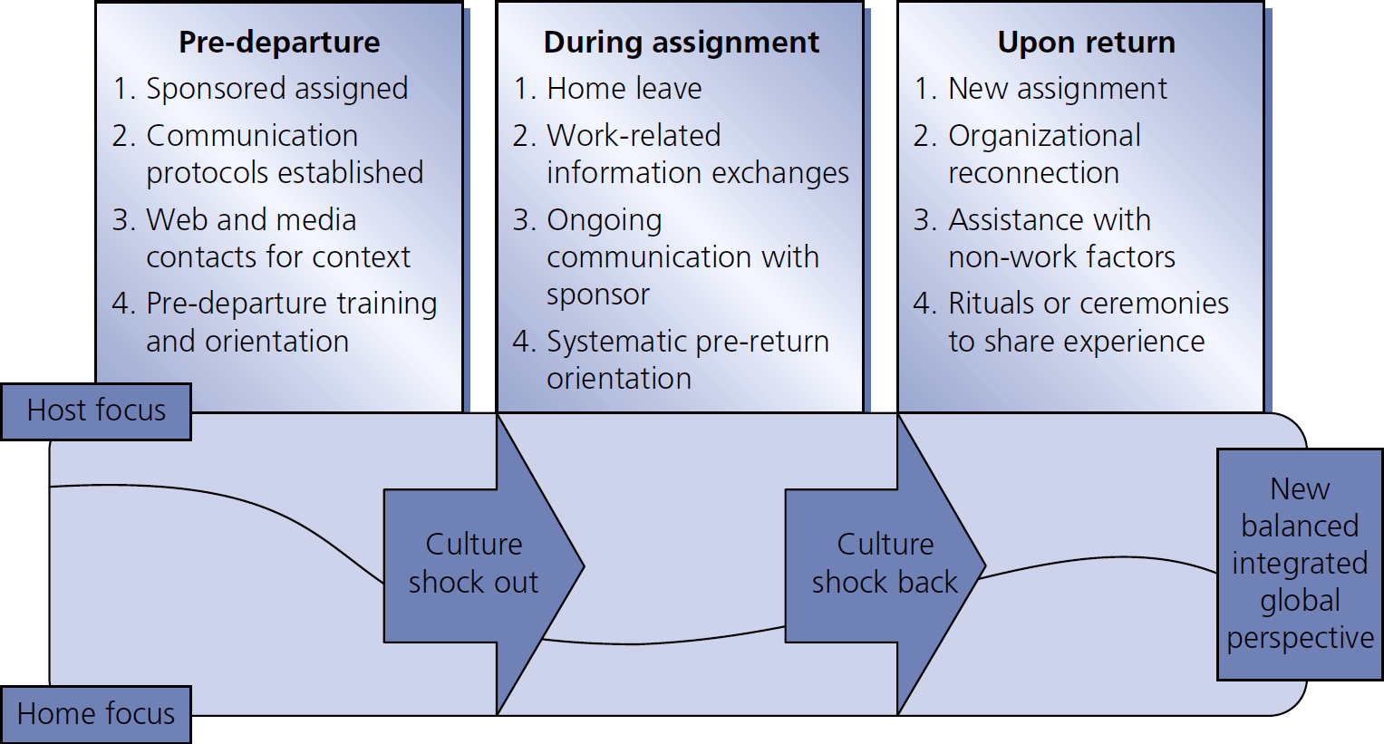
Figure 7.3
Expatriation includes repatriation

Slide 26
Figure 7.4
Repatriation activities & practices

Slide 27
Repatriation process

Slide 28
2011 Study: causes for international assignment failure
Spouse/partner dissatisfaction 18%
Poor candidate choice 16%
Poor job performance 13%
Inability to adapt 12%
Other family concerns 8%

Slide 29
Effectiveness of ways to reduce expatriate turnover
In most to least effective order:
Opportunity to use experience 35%
Position choices upon return 22%
Recognition 16%
Repatriation career support 13%
Improved performance evaluation 9%

Slide 30
Individual reactions to re-entry

Slide 31
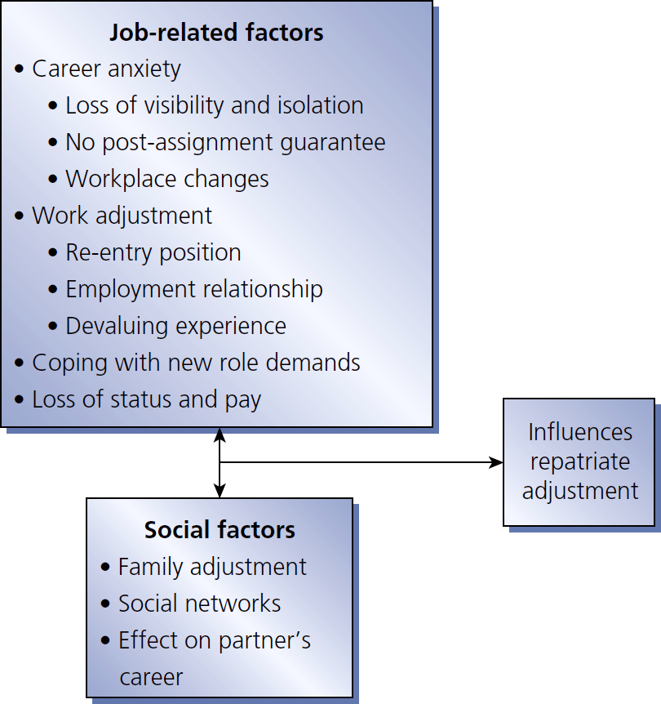
Figure 7.5
Factors influencing repatriate adjustment

Slide 32
Table 7.3
Career impacts of international assignments

Slide 33
Responses by the MNE

Slide 34
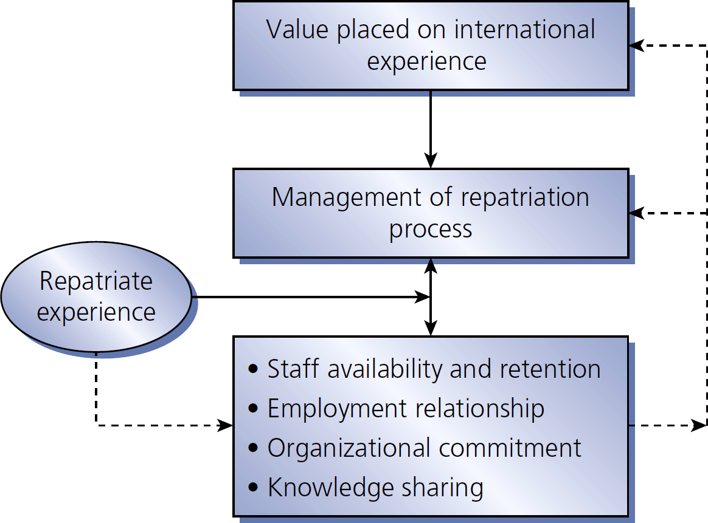
Figure 7.6
Linking repatriation process to outcomes

Slide 35
Knowledge & skills acquired from international assignment
Market specific knowledge local systems (political, social, economic), language, customs
Personal skills inter-cultural knowledge, self-confidence, flexibility, tolerance
Job-related management skills communication, project management, problem-solving
Network knowledge meeting diverse people
General management capacity broader job responsibilities, exposure to other parts of the organization

Slide 36
Designing a repatriation program

Slide 37
Table 7.4
Topics covered by a repatriation program

Slide 38
Strategies for smooth re-entry
Pre-departure briefings on what to expect & upon return
Multiple career planning sessions
Written repatriate agreements clarifying available assignments upon return
Mentoring programs that continue after return
Extended home visits to keep up with social, family, & organizational changes
Reorientation programs on changes in organization
Personalized financial & tax advice
Providing an adjustment period upon return
Visible & concrete expressions of repatriate’s value to the firm

