Slide 1
NIKE INC.
Anyssa Dagnino
Ana Merino
Chantal Montano
Yvonne Tafoya
MGMT 489
New Mexico Highlands University
Dr. Luis Ortiz

Slide 2
Board of Directors
Ultimate decision-making body of Nike
Review and establish procedures
Elects corporate officers
Ensure management team is executing their duties correctly and in a timely manner
Approve strategic direction for the management team

Slide 3
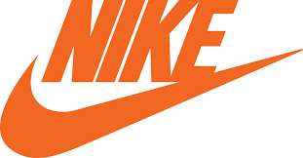
The size of the Board should contain 10-14 members.
13 members currently serving
Should offer diversity so that decision making is not hindered
Selection of Chairman and CEO is done so by the Board of Directors

Slide 4
Nominating and Corporate Governance Committee
There is no policy stating how many other companies a director can serve on
When the Committee is deciding on who to choose for the directors they take into consideration how many other Boards they are currently serving on
When a directors occupation changes often during their involvement with the Board they are asked to submit a resignation letter

Slide 5
HISTORY
1950s:
Bill Bowerman, Portland, Oregon native, becomes a track coach for the University of Oregon
Led the university to 4 NCAA track titles
Late 1950s, began obsession of creating a lighter shoe
Suggested new ideas to shoe companies but was denied
Took matters into his own hands and learned how to make a basic running shoe
Recruited Phil Knight, an athlete of Bowerman, to try the first-ever “Bowerman” original
A teammate of Knight took a liking to Knight’s shoes and asked to barrow them
Won a conference championship and a gold medal in the 400 meters a decade later at the 1960 Olympic Games

Slide 6
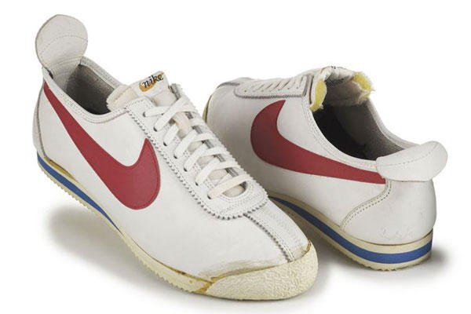
HISTORY CONT.
1960s:
Phil Knight completed his bachelors degree in business at the University of Oregon
Traveled to Japan after school and built a relationship with a Japanese firm called Onitsuka Tiger Co.
Invented “Blue Ribbon Sports”; New production of athletic shoes
Knight brought onboard Bowerman who invested 50-50 in the new business
1964 was the first year of Blue Ribbon Sports
A total of 1,300 pairs had been sold to total a gross income of $8,000
The company purchased their first retail space in 1967 (Santa Monica, CA)
Soon after expanded to the East Coast
Found their first big seller: a shoe called Cortez
Became Blue Ribbon Sports Inc. in 1968

Slide 7
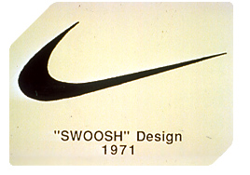
1970s:
Faced its first obstacle: could not afford expansion
Solution: to manufacture its own line of products overseas
Marketed the own products in the 1972 Olympic Trials
Prominent athletes wore the company’s shoes
Changed from Blue Ribbon Sports to Nike
A graphic design student created the Nike “swoosh” for $35
First-ever “Moon” shoe was created
Shoe made by molding rubber in a waffle iron
In 1972 broke away from Onitsuka Tiger
New Products brought in a gross income of $1.96 million
Nike signed its first athlete endorsement
Revenues tripled to $14 million then eventually to $28 million
International sales expanded to: Asia, South America, and Europe
Sold half the running shoes in the U.S.
Launched a new line of sports clothing

Slide 8
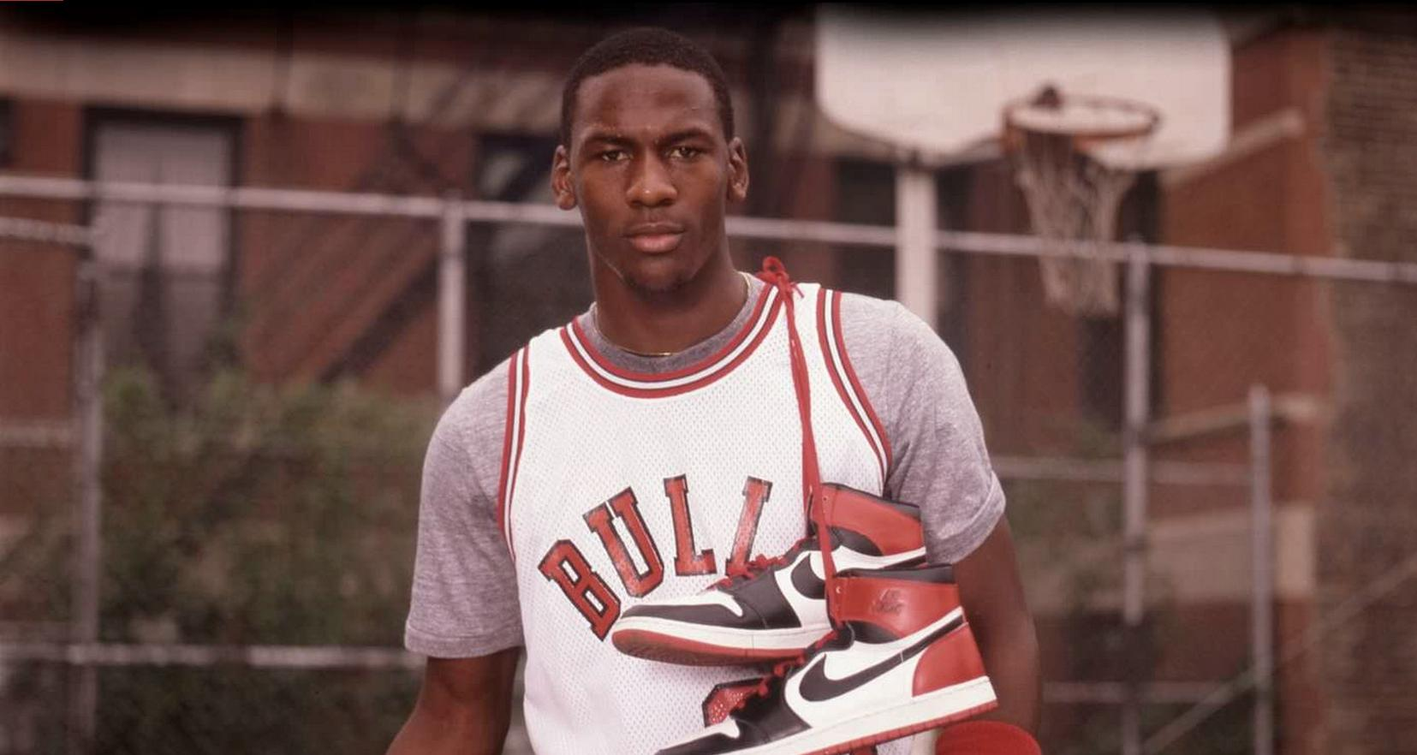
1980s:
Established factories in mainland China, Latin America, Europe, Japan, and Africa
In 1982 designed its first shoe made for grass/turf
Equipped the winning team in the English and European Cup
Dropped behind Germany because of a quarterly drop in earnings
Invested in a national television and magazine advertising campaign
Signed Michael Jordan
New face of the “Air” shoe
After new strategic advertising plan, Nike led the market again
$1.7 billion in sales

Slide 9
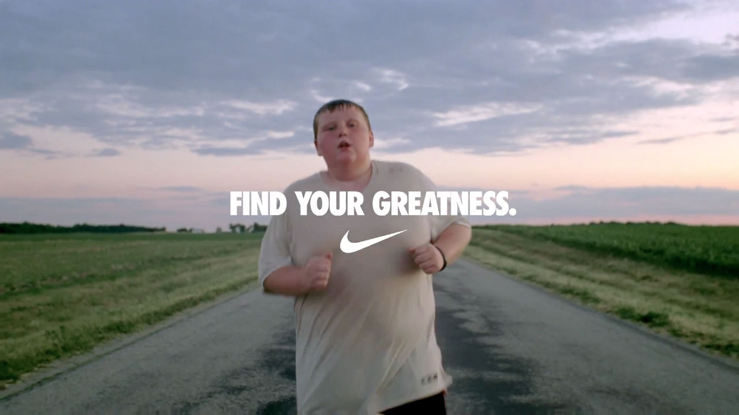
Marketing Strategy

Slide 10
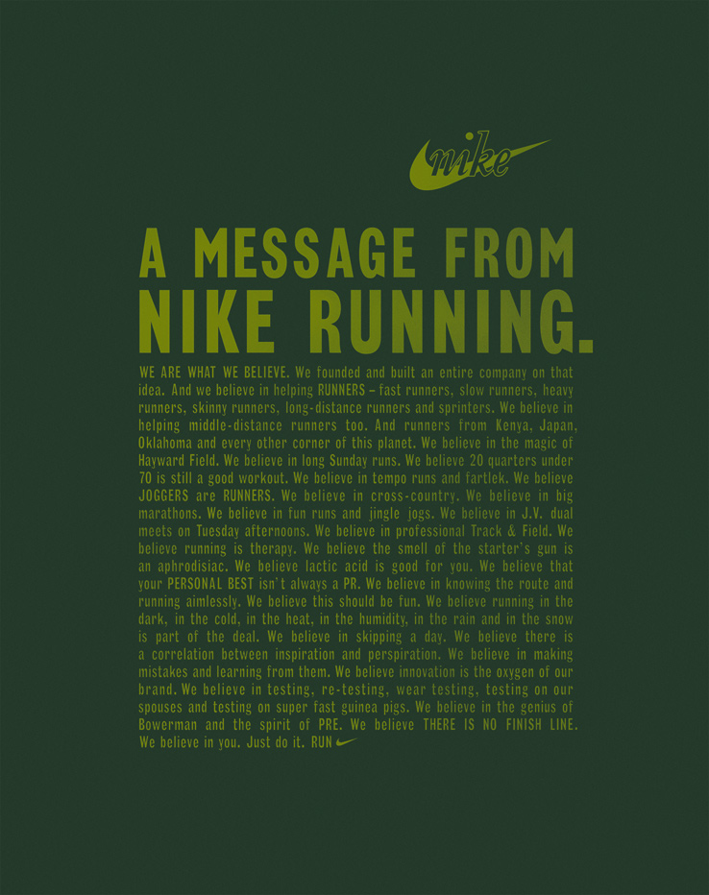

Slide 11
Nike’s Financial Statements

Slide 12
Nike’s Management

Slide 13
Internal Environment
Owner’s are a reflection of the company’s values
Vital because they let the organization know what people are thinking, how they are feeling, and what they are doing at work
Benefits and programs for employees = good environment to work in:
Provides employees with opportunity to stay fit
Ensure the wellness of their families
Create a positive working environment
Marketing
Targets male and females between the ages of 18-34

Slide 14
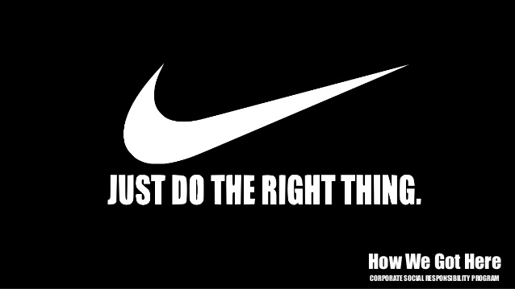
Internal Opportunities
Research/development
Research athletes they want to endorse
Decide which products suit the athletes best
Social responsibility
Fair Labor Association
Global Alliance for Workforce and Communities

Slide 15
External Environment
Presented through company financial statements and SWOT analysis.
Evaluated by stakeholders and board of directors
The external analysis for any company is crucial to the overall success or failure of it because a structured planning tool is necessary for proper in-depth analysis.
Nike is a company that has evolved through time into a corporate giant in every aspect.

Slide 17
Competition

Slide 18
References
Bill Bowerman: Nike’s Original Innovator. (2015, September 2). Retrieved October 01, 2017, from https://news.nike.com/news/bill-bowerman-nike-s-original- innovator
Business Dictionary
Business Insider Retail Dennis Green Nov. 13, 2016 Retrieved October 1, 2017
Forbes. (2012). What You Need To Know About Nike’s Phil Knight. Retrieved October 1, 2017, from http://www.forbes.com/sites/johnclarke/2012/09/10/what -you-need-to-know-about-nikes-phil-knight/
Life advice from Phil Knight Men's Journal Retrieved October 1, 2017 LLC, 1290 Avenue of the Americas, New York, NY 10104-0298
NIKE Inc.-Company Profile, Information, Business Description, History, Background Information on NIKE, Inc. (n.d.). Retrieved October 01, 2017, from http://www.referenceforbusiness.com/history2/99/NIKE-Inc.html
http://nytimes.com/1989/07/11/business/nike-is-bounding-past-reebok.html?mcubz=1
http://fashiongear.fibre2fashion.com/brand-story/nikeinc/history.asp
http://www.mensjournal.com/entertainment/articles/life-advice-from-phil-knight-w431388

Slide 19
References Continued
SWOT Analysis of Nike Management Study Guide Retrieved October 1, 2017 https://managementstudyguide.com/swot-analysis-of-nike
http://www.businessinsider.com/adidas-and-under-armour-are-fighting-to-be-nikes-top-us-competitor-2016-11
https://seekingalpha.com/article/4062826-nike-vs-adidas-vs-armour
https://themediaedit.wordpress.com/2016/09/02/should-it-be-the-responsibility-of-the-corporate-world-to-solve-societal-problems-nike-and-corporate-social-responsibility/
Nike Basketball https://youtu.be/n6S1JoCSVNU
Published on Oct 30, 2014
This time it's bigger than basketball.
Category
Sports
License
Standard YouTube License

