Slide 2
COMPANY OVERVIEW HISTORY
Au bon pain Co., Inc., stablished in 1981
1997 was renamed.
2007 – 2016.

Slide 3
COMPANY OVERVIEW
BOARD OF DIRECTORS
Ronald M. Shaich; Founder, Chairman & CEO of Panera Bread.
William W. Moreton; Executive vice chairman.
Domenic Colasacco; Lead Independent Director since March 2007,
Director since March 2000.
Diane Hessan; Director since November 2012.

Slide 4
COMPANY OVERVIEW
BOARD OF DIRECTORS
Fred Foulkes; Director since June 2003.
Larry Franklin; Director since June 2001.
Thomas E. Lynch; Director since March 2010.
Mark Stoever; Director since January 2016.
James White; Director since January 2016

Slide 5
MISSION STATEMENT & VISION STATEMENT
MISSION STATEMENT
“A loaf of bread in every arm”
VISION STATEMENT
Be excellent at everything we do.

Slide 6
EXECUTIVE SUMMARY TARGET MARKET
32.6 %
67.4%

Slide 7
EXECUTIVE SUMMARY EXPANSION PLAN
5 Year vision plan
Panera 2.0
Operations
Food
Marketing “ Food as it should be”
Delivery
Catering
Panera at home
High-ROI unit growth
E-commerce

Slide 8
FINANCIAL RATIOS 2008-2016

Slide 9
SWOT ANALYSIS
Strengths
Catering
Supply Chain
Franchises
Weaknesses
High Price
Not a Global Chain
Opportunities
Merger and Acquisition
International Expansion
Enhance the Promotion of Panera Culture
Threats
Competition
Changes in Food and Supply Cost

Slide 10
Strategies
Expansion Strategy
Marketing Strategy
Advertising Strategy
Brand Strategy

Slide 11
Expansion Strategy
Panera Bread opportunities to grow keeps expanding each year.
Expanding Panera at Home
Expanding their delivery services to all franchises.
Focus on reaching more consumers by promoting their unique and superior value in their products.
Continue to grow the catering service while searching for options to make catering services separate from Panera Bread dinning locations.

Slide 12
Panera Bread at Home
Expansion of product line sold at grocery stores including refrigerated Panera Bread dough, coffee, soup, dressings, frozen cookie dough, and all natural Panera Bread chips. It will increase the number of consumers reached and expand name recognition into new areas.

Slide 13
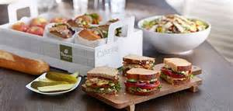
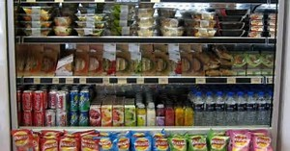
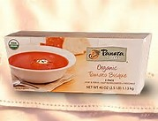
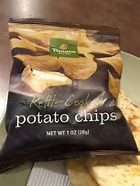
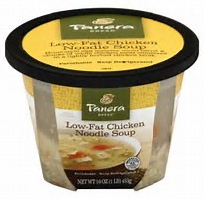
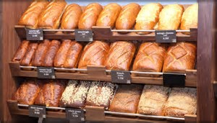
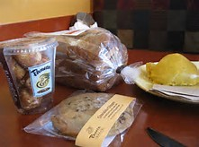

Slide 14
Feeding America
What other opportunities can Panera Bread explore:
Testing a Panera Bread Food Truck to reach customers at concerts, sporting events from High School to Professional sporting events.
Food Trucks can access a wide range of consumers in different venues and expand locations.
Develop in highly populated areas such as universities, large downtown areas, and corporate districts.

Slide 15
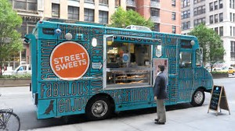

Slide 16
Marketing Strategy
Panera Bread compromise to the promise of delivering “Food as it should be”.
Panera maintains promise of loyalty to customers by serving them premium and healthy food.
Also, an idea is to have Panera bread promote new price deals including discounts for students, seniors, and military personnel.
Implement incentives for customers to participate in social media promoting their best times with Panera Bread and reward winner of competition with products from stores.

Slide 17
Panera Bread Promise
Clean
No artificial preservatives, sweeteners, flavors or colors from artificial sources.
Savored & Enjoyed
At a table. Alone or together with family and friends.
Nutrient-Rich
With wholesome ingredients like fruits and vegetables.
Raised Responsibly
Sourced from farms that respect the food they produce.
Personalized
Curated and customizable menu so you can eat the way you want.
Transparent
A menu that doesn’t hide from the people it feeds.

Slide 18
Advertising Strategy
Increasing air time for commercials in new networks such as Sports channels, mainstream channels and radio.
Panera Bread advertising of new products on Sunday and Monday by giving test samples to customers willing to try upcoming products.
Target schools from High Schools to Universities for advertising space.
Also, to increase commitment for Kids Promise promoting Panera Bread healthy food choices will offer discounts when teams choose to participate in ordering from PB for team meals.

Slide 19
Brand Strategy
Panera Bread has positioned its brand as a place with
quality healthy food
clean and transparent
customer loyalty
Participates with community with major programs such:
Panera Cares Community Breadbox: We put the cash donations you make in our bakery-cafes to work supporting local non-profit organizations in your communities.
Panera Cares Community Cafes: The Panera Bread Foundation’s non-profit bakery-cafes work with customers to help feed those in need. Panera Cares community cafes are about working together, shoulder to shoulder with our customers, to confront a serious problem plaguing communities across this country. Hunger
Bakers-In-Training: Bakers-In-Training program is a great way to introduce children to kitchen essentials, and the fundamentals of baking.

Slide 20
Panera Gives Back
Fundraising Nights: Looking for a way to raise money for your organization? We'd love to help and it's a great way to combine great taste and great fun - for a great cause. Schedule a night to host an event at your local bakery-cafe, invite your friends and family, and we'll donate a portion of sales directly back to your organization.
Scrip Fundraising: We proudly participate in the Scrip fundraising program, helping nonprofit organizations raise money.
Day End Dough-Nation: At the end of each day, our bakery-cafes package unsold bread and baked goods to donate to local hunger relief and charitable organizations
Panera Gives: We support events held by non-profit organizations serving those in need by donating a certificate or fresh bakery products.

Slide 21
Awards & Recognitions
2017
Hospitality Technology
2017 Top Women in Foodservice Technology Innovator - Anita Klopfenstein
2016
Fast Casual
Ranked #4 in Fast Casual's Top 100
2015
Fast Company
#1 Most Innovative Company in Food #27 Most Innovative Company
TDn2K (Transforming Data into Knowledge)
Heart of the Workplace Award
2015 Continue
Fast Casual
Award of Excellence
Reputation Institute
Ranked #1 in Hospitality Industry
FARE Foodservice Awards
Honored as 2015 Leader in Foodservice
Restaurant Business Magazine
Tech Accelerator of the Year

Slide 22
Consumer Response
Through the introduction of the artisan menu and healthy alternative options to a broader healthy conscious consumers, profit and competitive advantage will continue to thrive.
Panera 2.0 allows customers to have a healthier “fast food” selection without taking too much time off their busy schedules.

Slide 23
Expected Response
Panera Bread will continue to enjoy the fresh and healthy food options offered by PB and will try and test out the Panera Bread Food Truck to be more convenient when customers can have the option of a healthy option if sandwiches while enjoying concerts or sporting events.

Slide 24
Thank you!
Resources
Panera Bread official website
Panera Bread: Case 13

